Slide 1
Building the OpenAutoScope
2017 February
Update 2018 November
Contributors: Nathan Cermak, Philip Kidd, Stephanie Yu, Andrew Bahle

Slide 2
General build overview
Assemble optical components
Assemble linear axes on breadboard
Assemble circuit board
Putting it all together
Bolt optics to linear axis carriage
Connect motors, LED and laser to circuit board
Connect circuit board to computer
Software and testing

Slide 3
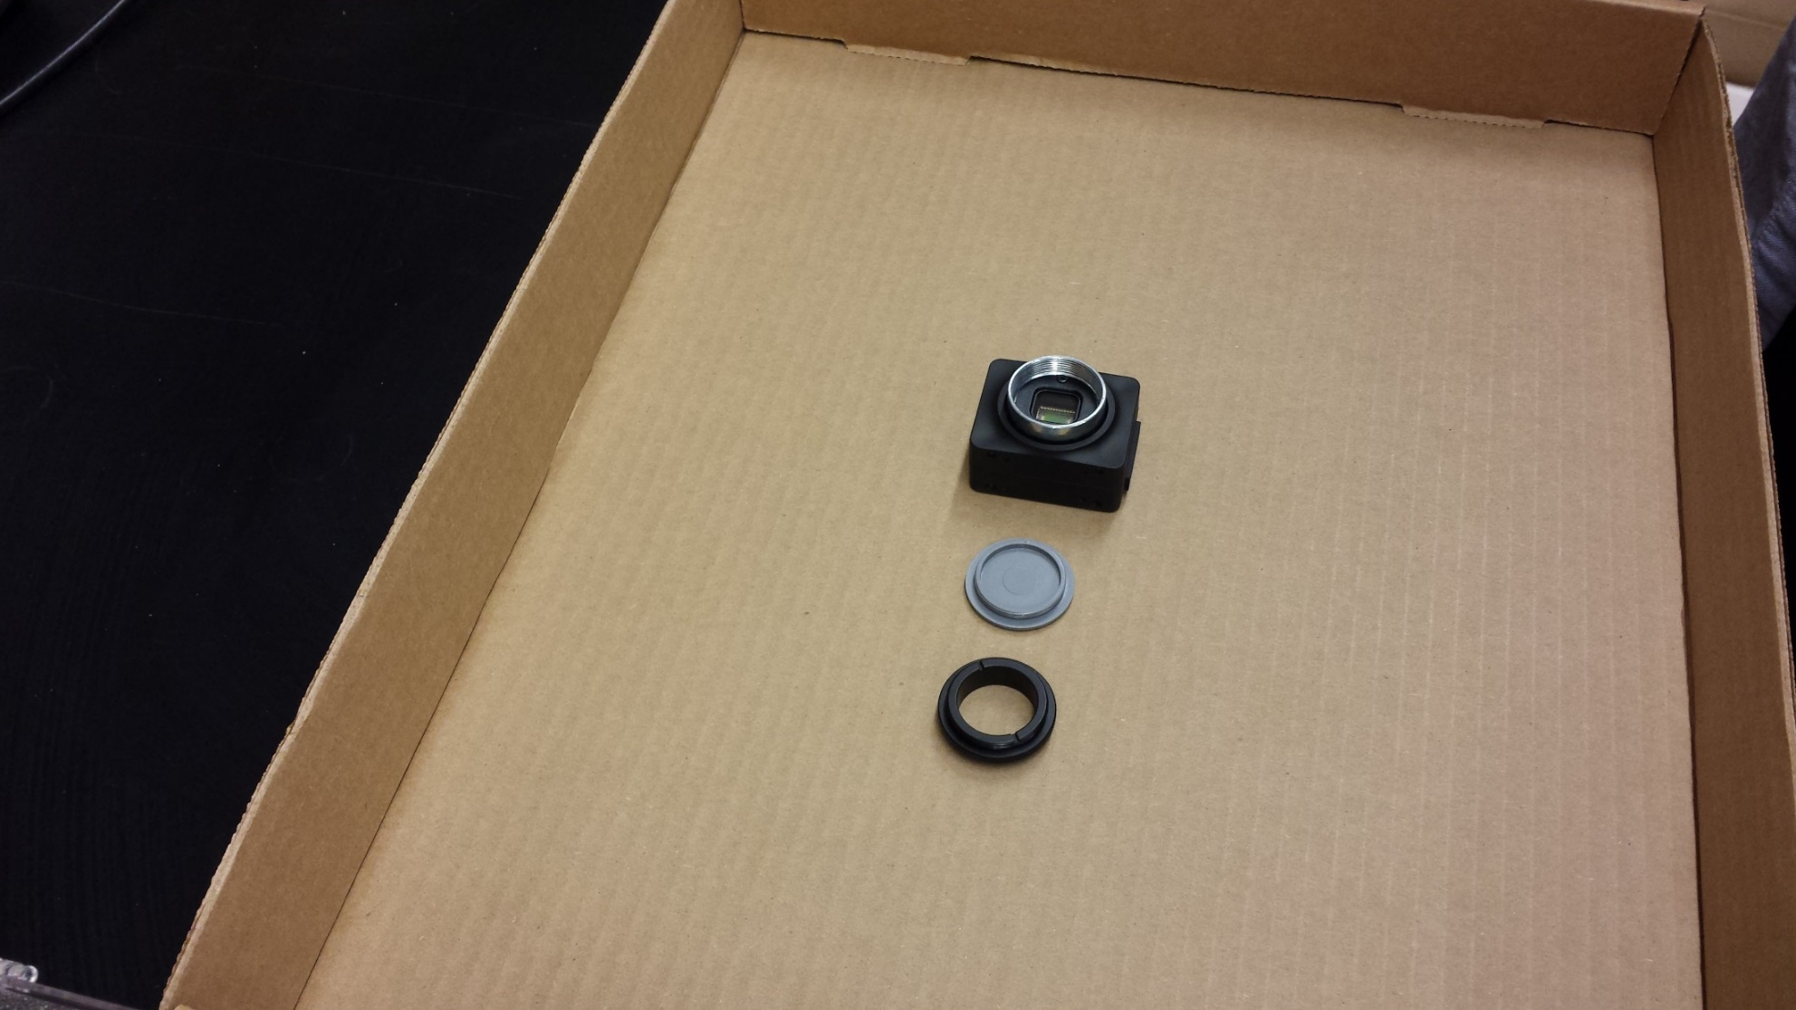
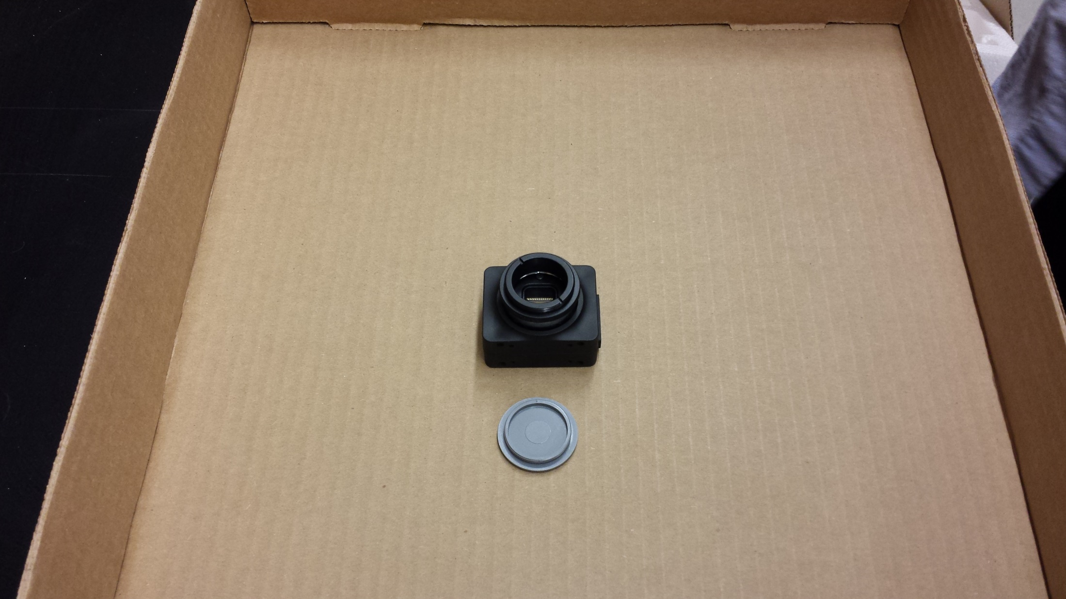
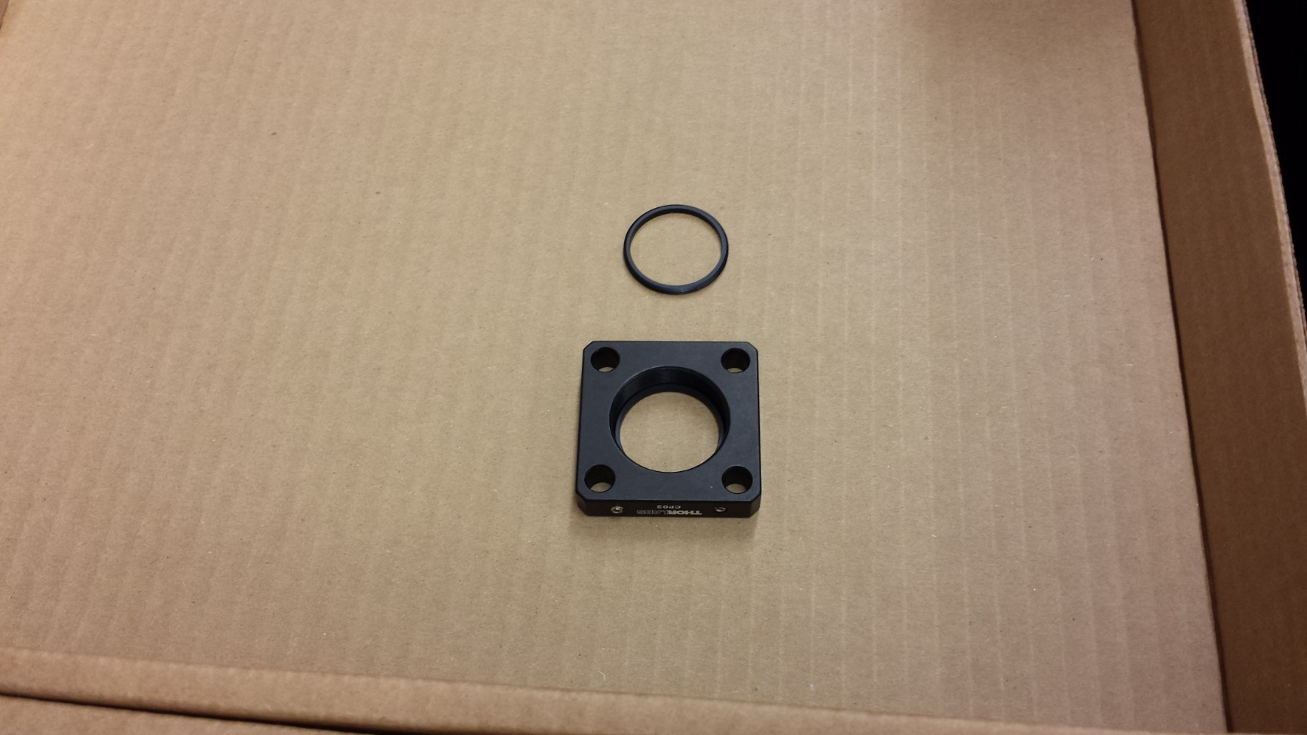
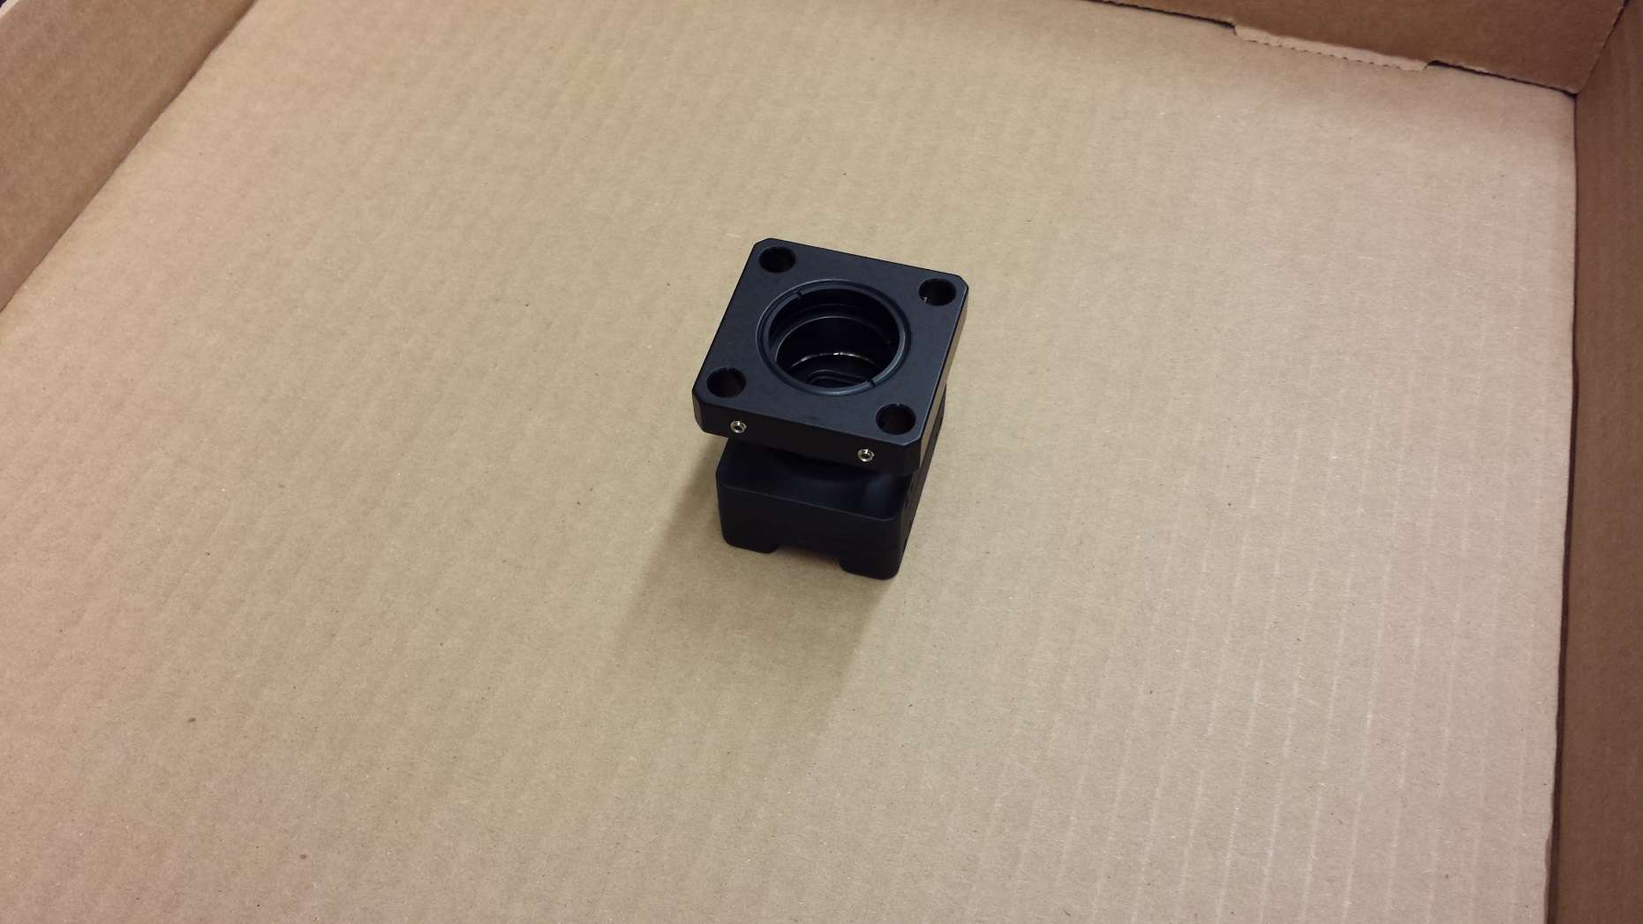
Attach camera to cage plate
1) Remove camera cap (grey)
2) Attach thread adaptor (thorlabs SM1A39)
3) Take a cage plate, remove one retaining-ring. Screw the other one in deeper to about half-way in.
4) Screw cage plate onto camera adaptor. Read note below.
Note – in step 4, you want the camera to wind up square with the cage plate, not at some funky rotation. To achieve this, screw in the remaining retaining-ring so that when you screw in the camera it tightens at the correct angle.

Slide 4
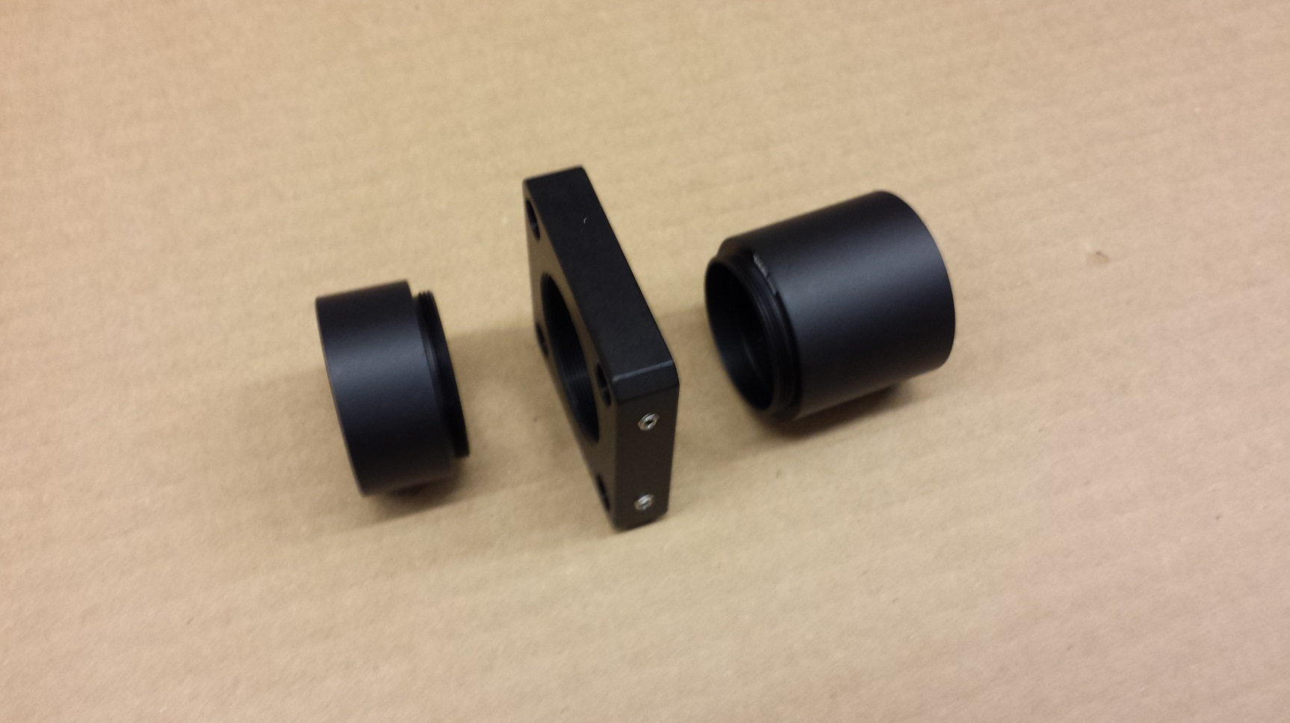
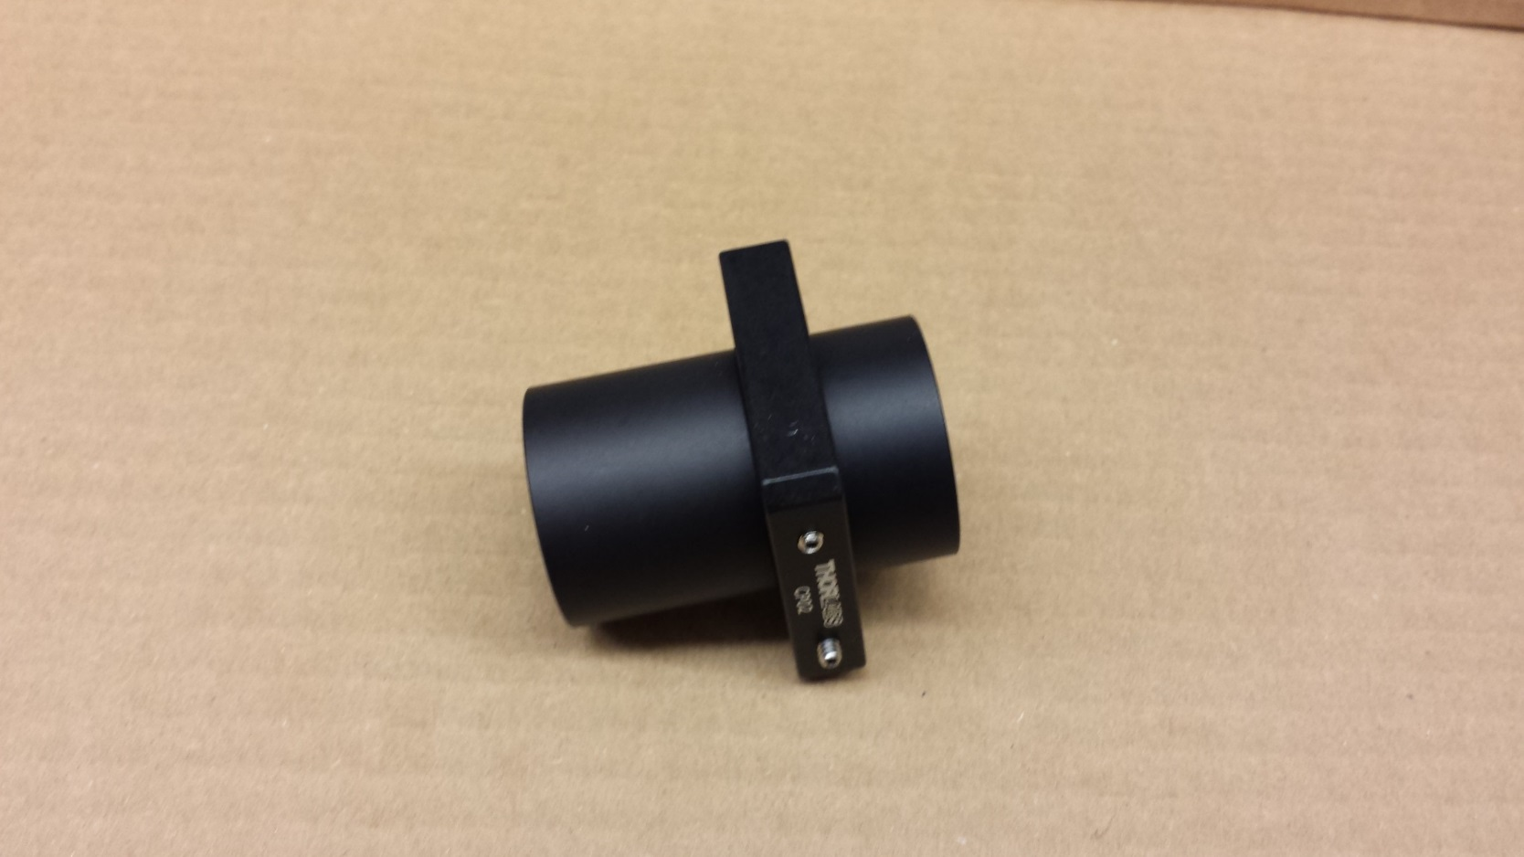
Attach another cage plate to lens tubes
1) Take a cage plate, remove both retaining-rings. Get 1” and ½” lens tubes.
2) Screw in lens tubes.

Slide 5
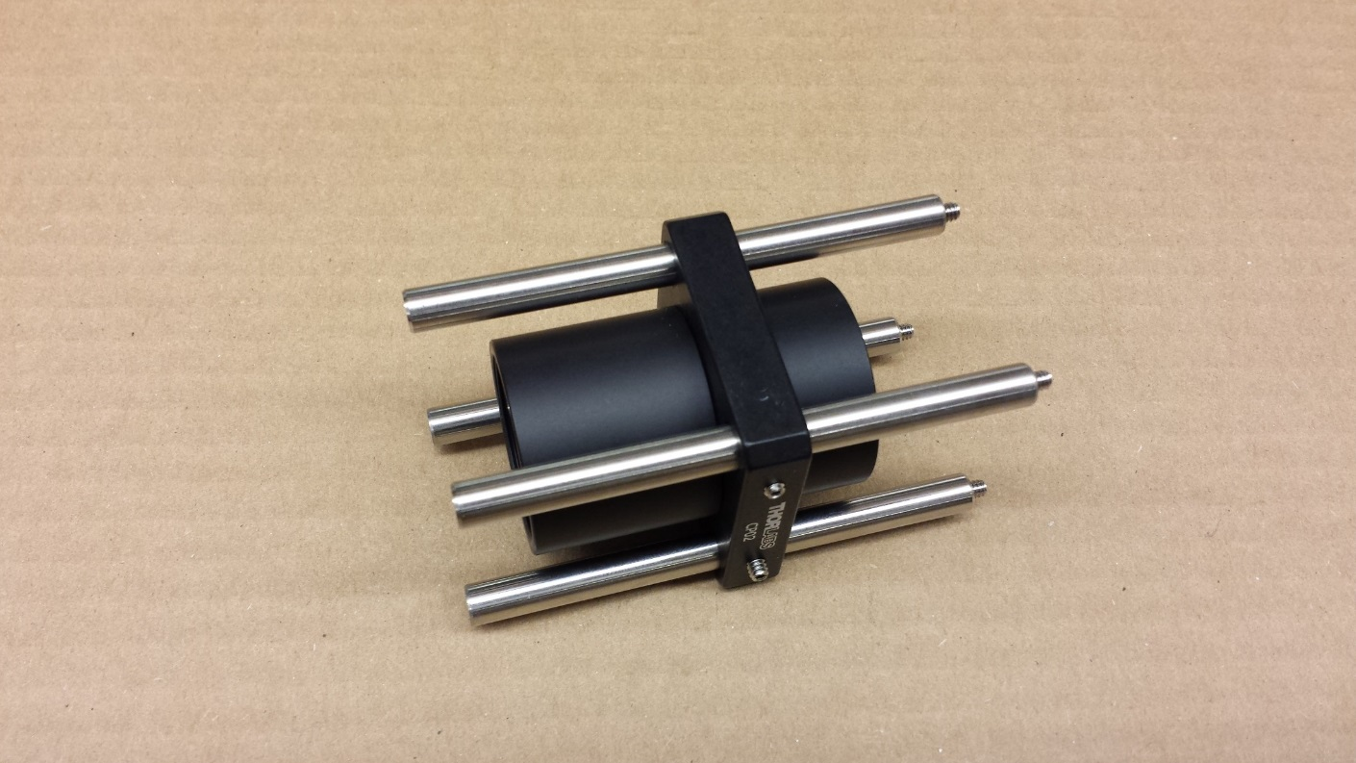
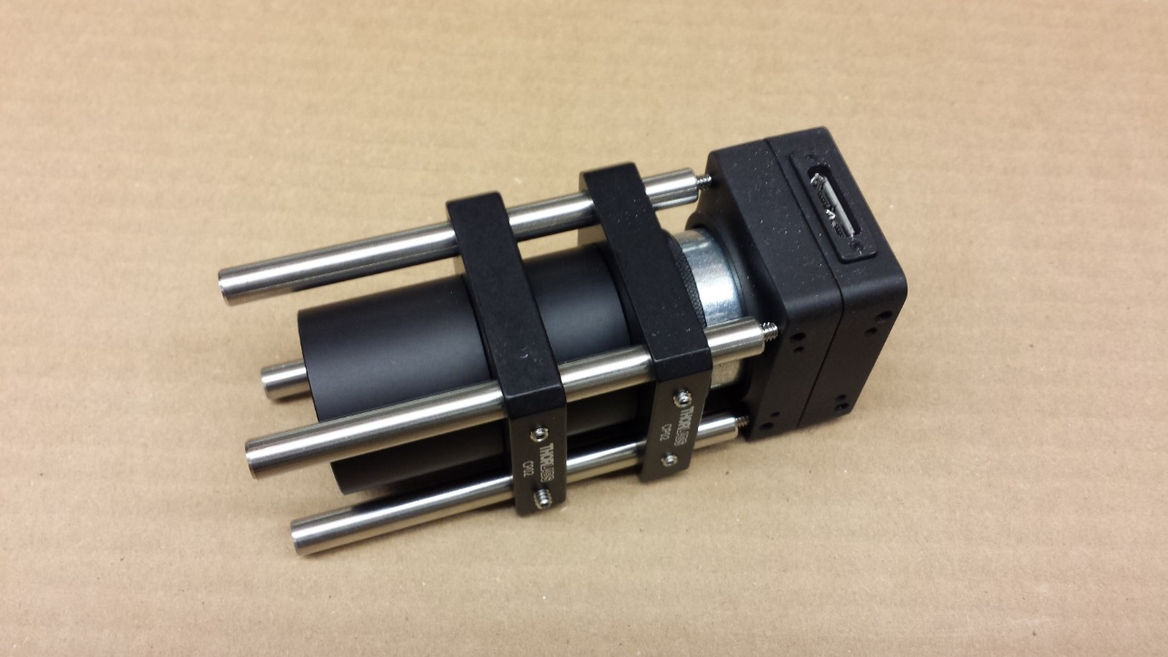
Attach camera and lens tubes via cage rods
1) Slide 3” cage rods through cage plate. Remove the screws on the ends of the cage rods (circled).
Don’t tighten the set-screws on the side of the cage plate yet!
2) Slide the camera cage plate onto the cage rods. (Still don’t tighten the set screws on the sides of the cage plates).

Slide 6
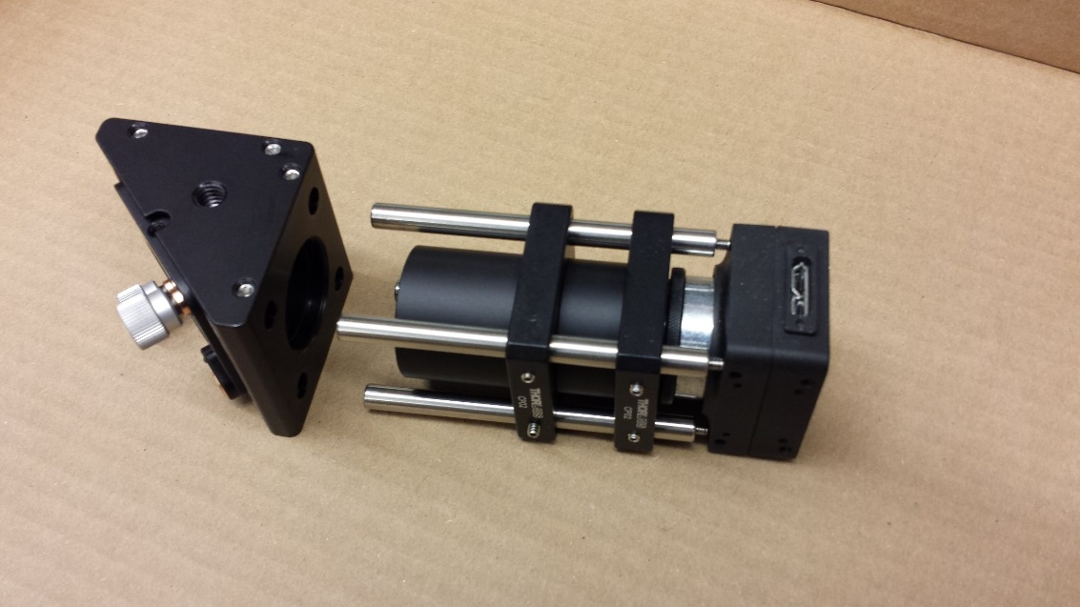
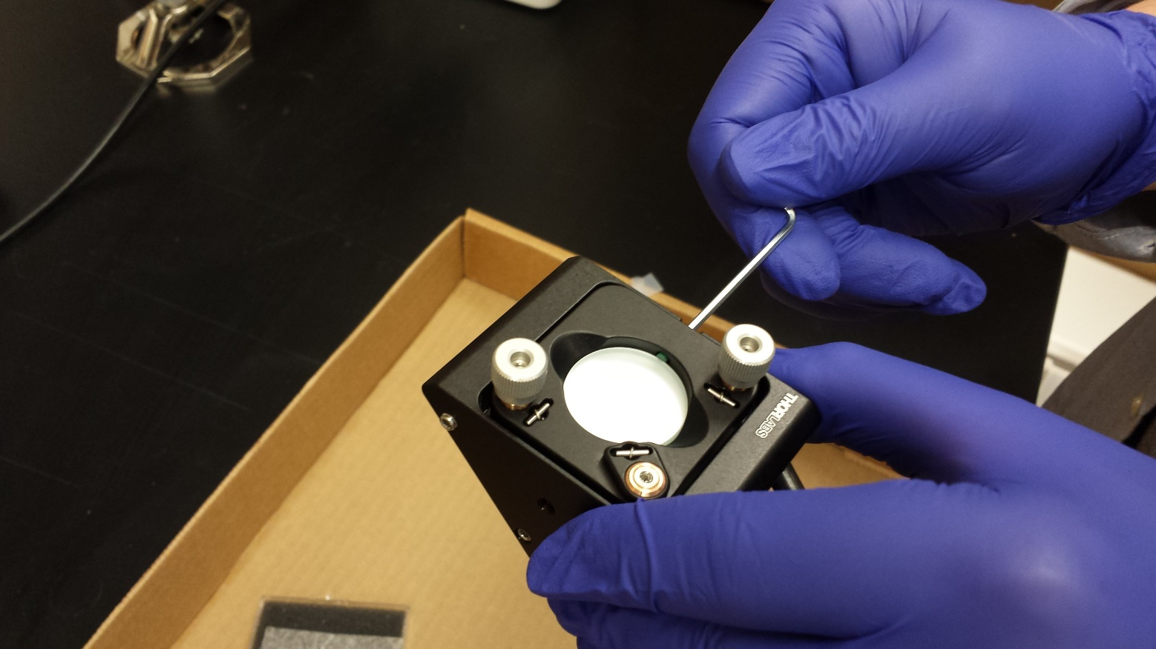
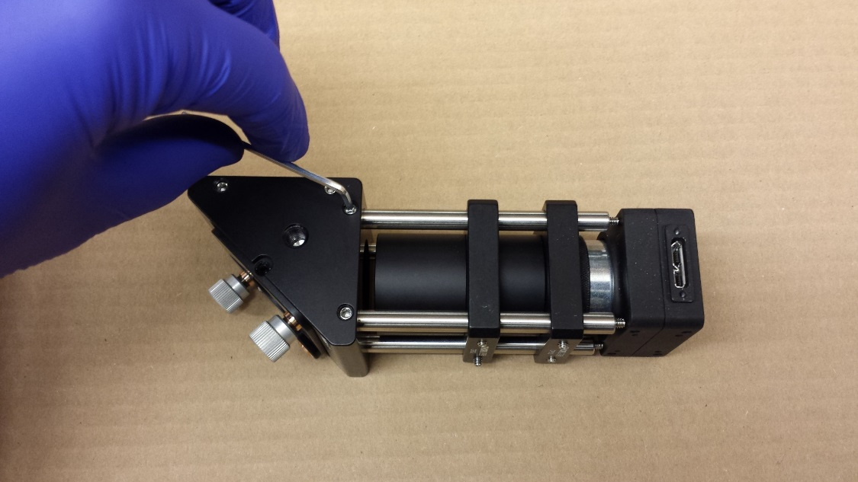
Assemble corner mirror (KCB1C) and attach cage rods
(ME1-G01)
1) Slide the cage rods into the KCB1C. Note that the corner mirror holder should have the ¼”-20 screw hole (the bigger one, red arrows) facing up. Tighten the set screws on top and bottom (as shown in the lower image).
2) Place the mirror (ME1-G01) in the KCB1C. Tighten the setscrew on top (as shown) just enough that the mirror is held firmly in place.

Slide 7
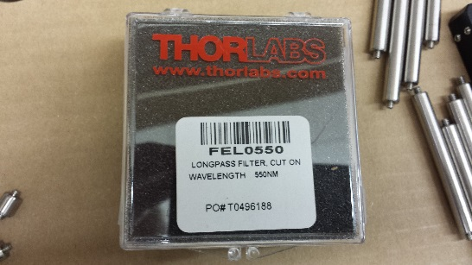
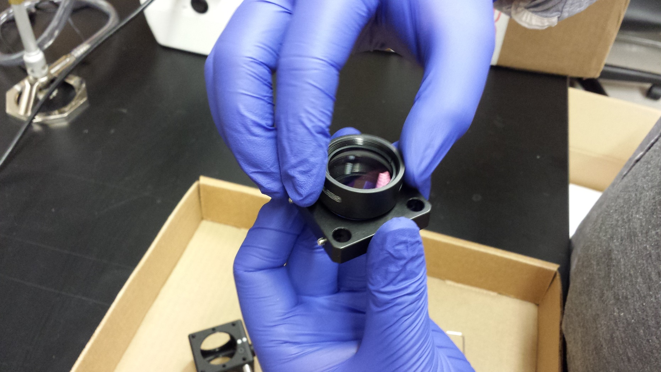
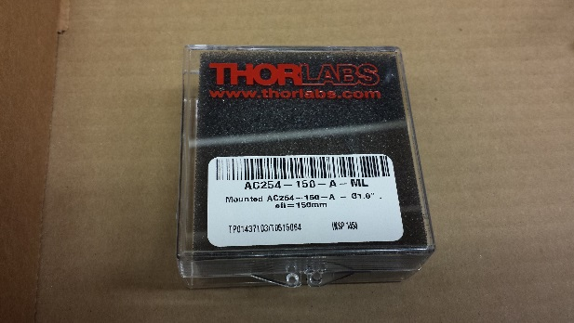
Attach 150mm lens (the ‘tube lens’) and filter to cage plate
Wear gloves to avoid finger prints on optics.
Remove both retaining rings from a cage plate. Screw AC254-150 lens in just a tiny way (just enough so its not falling off). Turn the cage plate over and drop in the FEL0550 filter, with the arrow facing away from the lens. Screw in one retaining ring (it will just barely begin to bite the thread) to hold the filter in place.

Slide 8
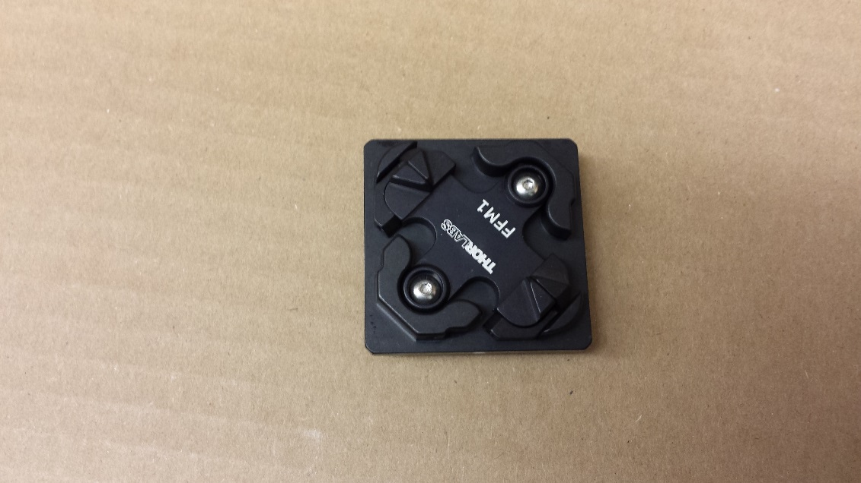
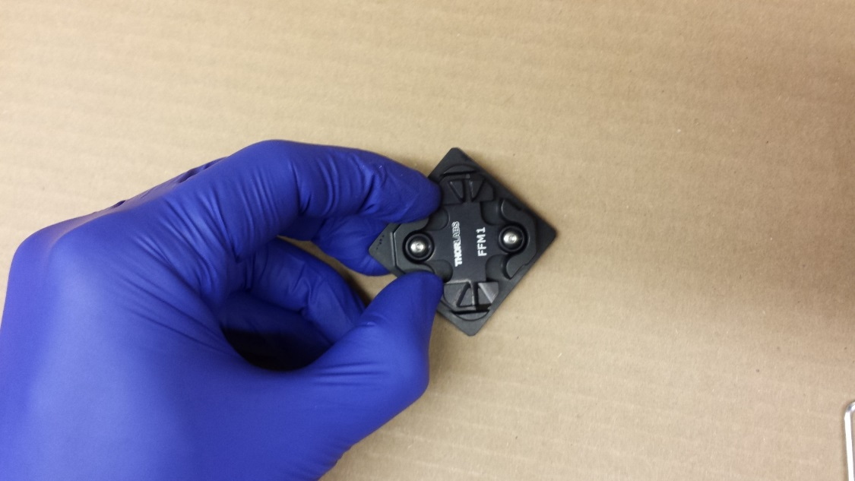
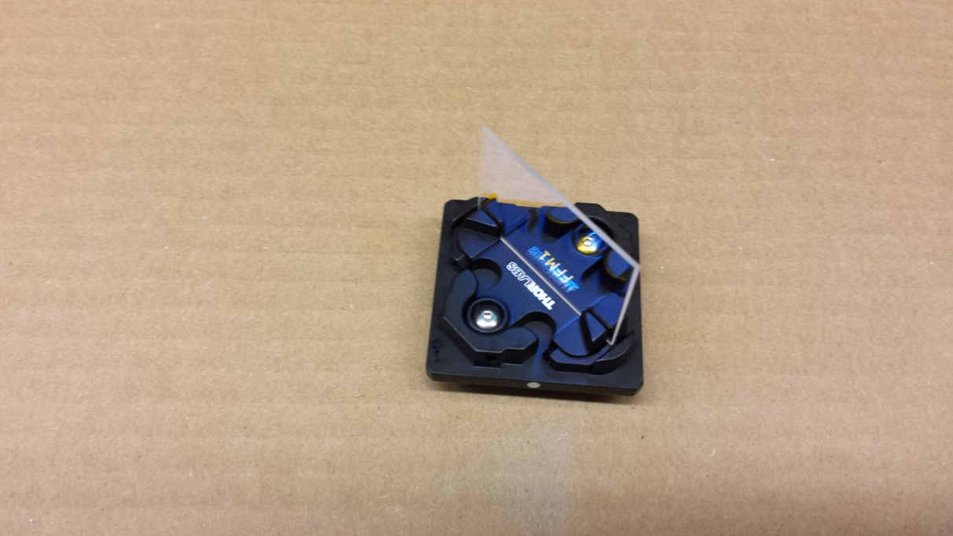
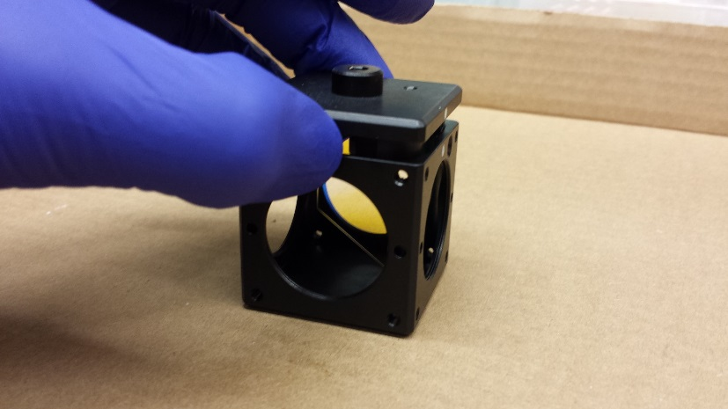
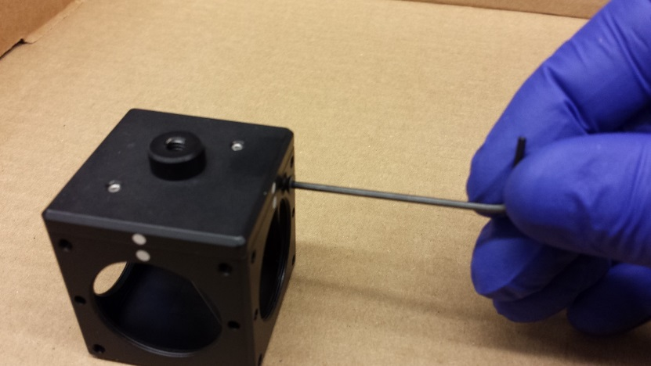
Insert dichroic into dichroic cube
1) Take off the top piece of the CM1-DCH dichroic cube.
2) Press from the sides to slide the teeth apart
3) Place the dichroic. NOTE: the dichroic has a coated side*, which should face in the orientation marked with the red arrow below.
4) Put it back inside the cube.
* To determine which side is coated, take a piece of lens paper or tissue and just gently touch it to the glass. If the lens paper touches its reflection, that’s the coated side. If not, it’s the uncoated side.
5) Put the screws back in to secure the top onto the cube.

Slide 9
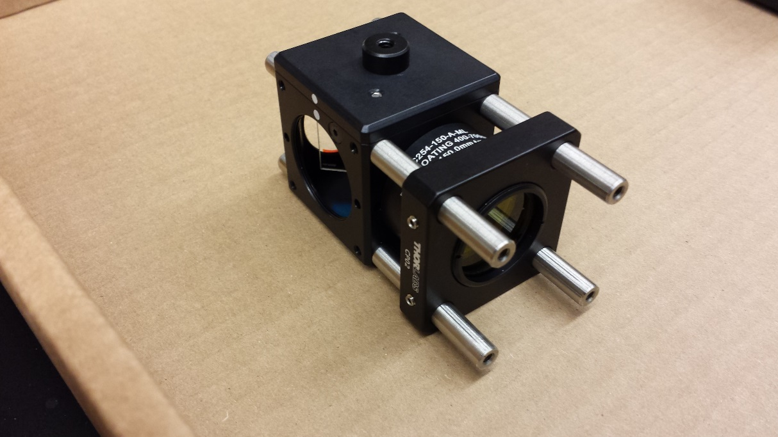
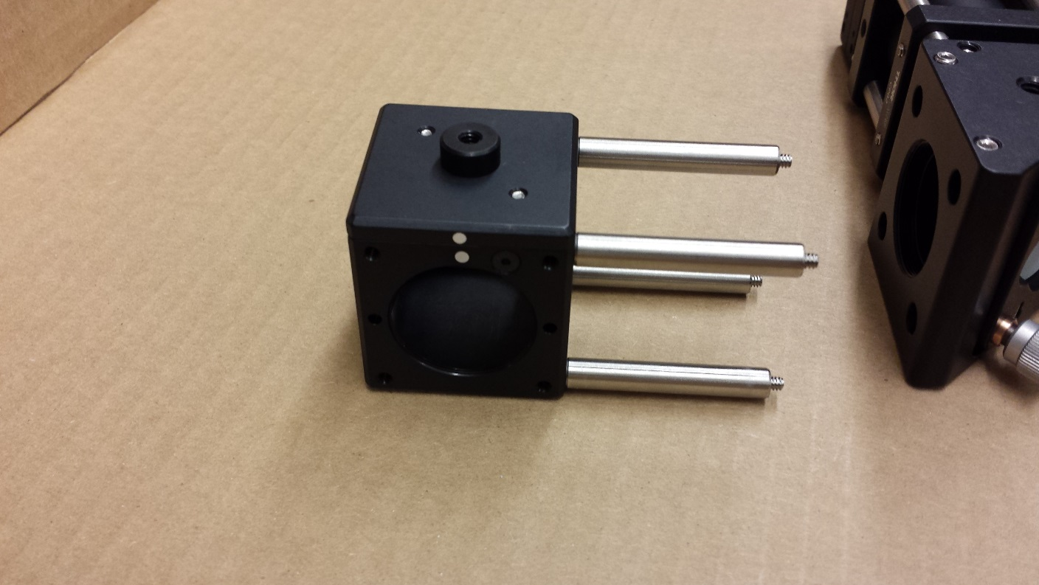
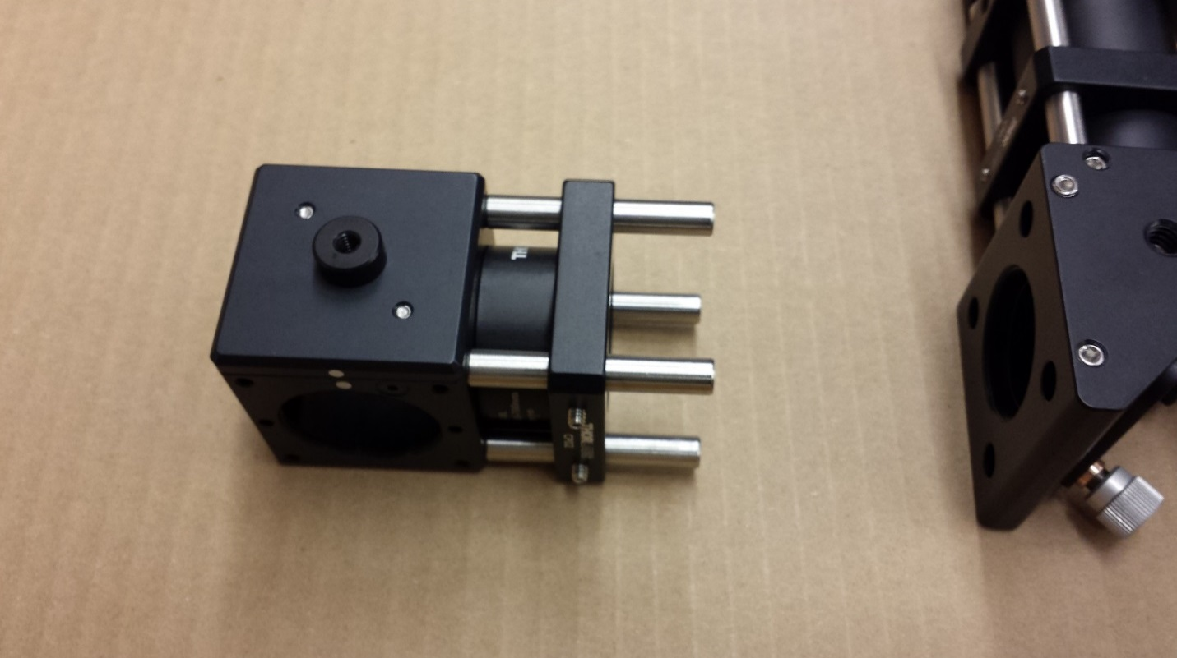
Attach 1.5” cage rods to dichroic mount, then slide on tube lens
1) Screw four 1.5” long cage rods into the dichroic cube (CM1-DCH), on a side without the screw denoted by the arrow.
(As another reference point, in this orientation, the dots [circled] should face towards you and to the left).
2) Remove screws at the ends of the cage rods.
3) Slide on the tube lens and filter from previous slide. Make sure the screw hole on the side of the cage plate is facing down!

Slide 10
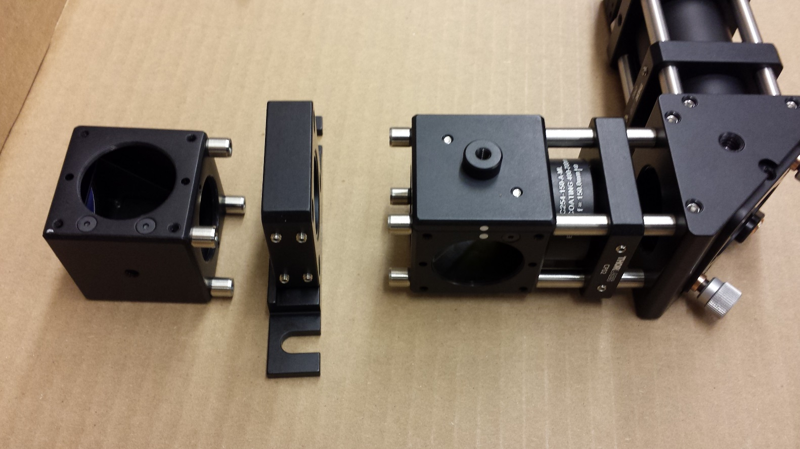
Attach dichroic piece to side of right-angle mirror holder (KCB1C)
Attach the 1.5” cage rods to the mirror holder, and tighten the set screws (red arrows), both top and bottom.
Screw in four ¼” cage rods onto the dichroic cube (green arrows).

Slide 11
Add base to thick cageplate (CP02T) add cage rods to right-angle mirror (CM1-G01)
1) Screw ¼” cage rods into right angle mirror (CM1-G01)
2) Attach base (CPB1) to the underside of thick cage plate (CP02T). The CP02T has two setscrews on the side, not just one!

Slide 12
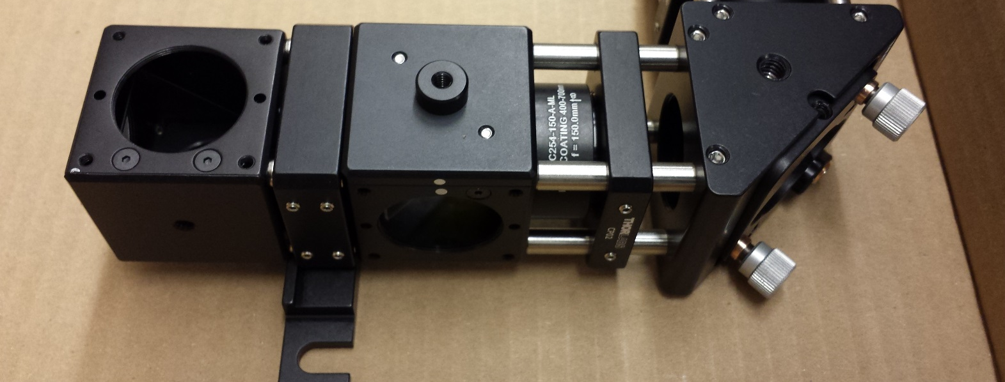
Connect the pieces
Slide both sides into the thick cage plate. There will be a small gap on the side of the right angle mirror piece due to the lip of the CPB1 baseplate (this is fine). Tighten all eight set screws (red arrows) on both sides.
At this point, the entire unit should feel like one solid piece. If it doesn’t, check all the setscrews throughout and that the cage rods are screwed all the way in.

Slide 13
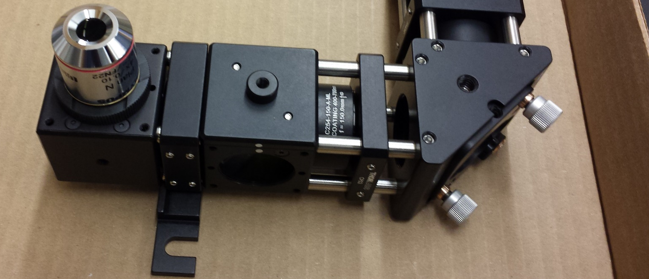
Attach the objective via the objective thread adapter
Screw the thread adapter (SM1A3TS) onto the right angle mirror mount, then screw the objective into that.

Slide 14
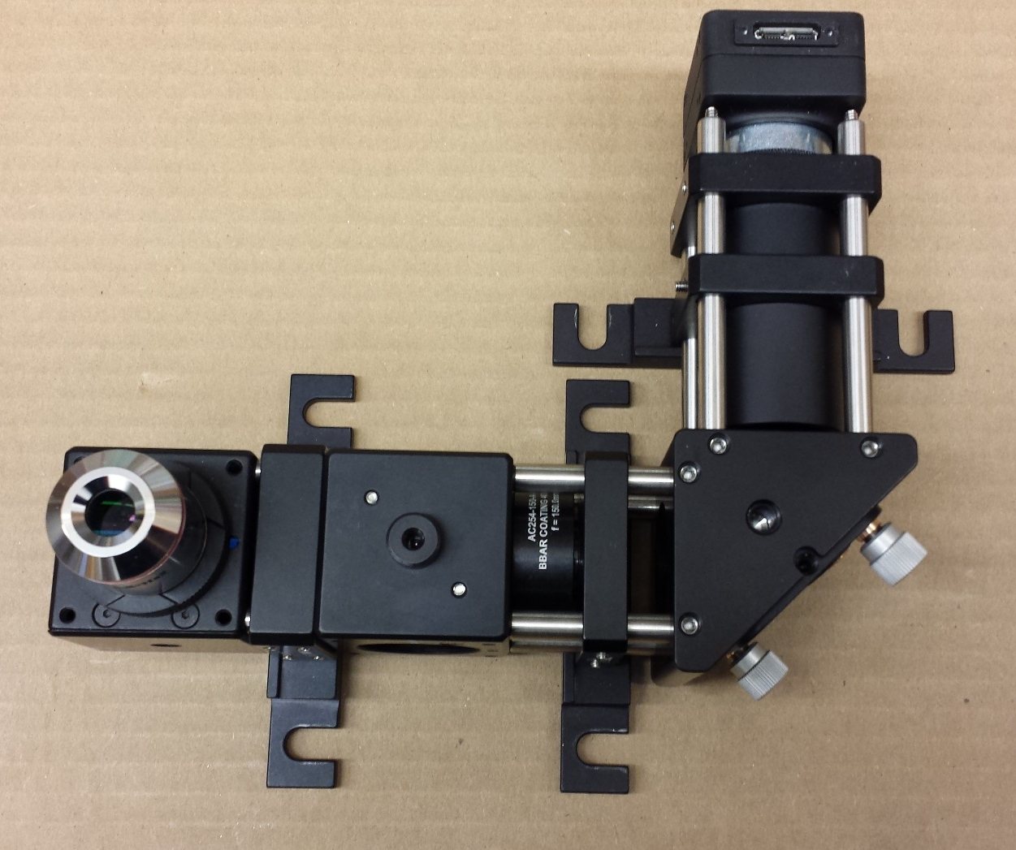
Attach the other two bases (CPB1s)
Bolt these guys onto their cage plates from the underside.

Slide 15
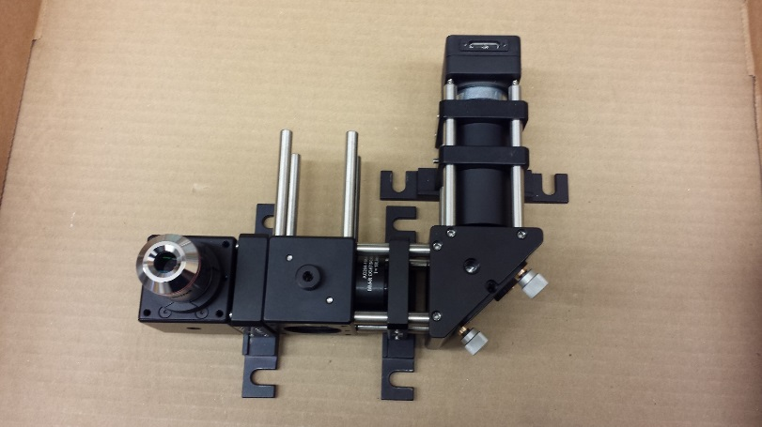
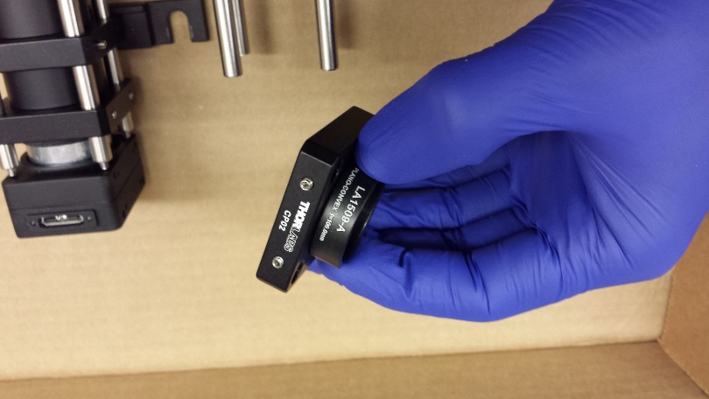
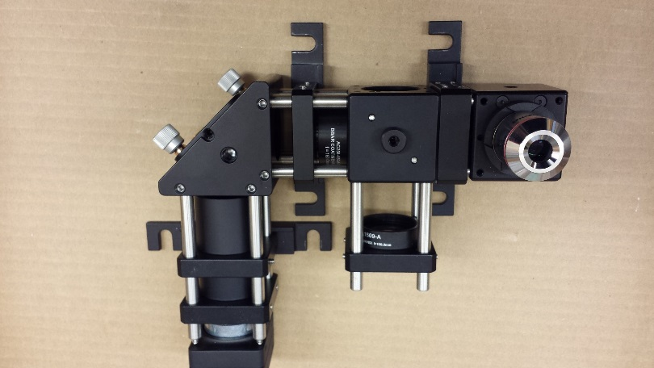
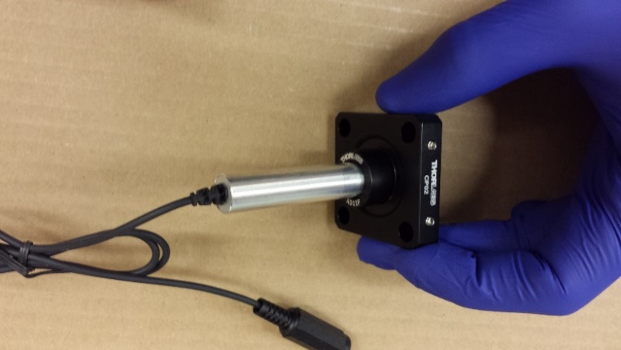
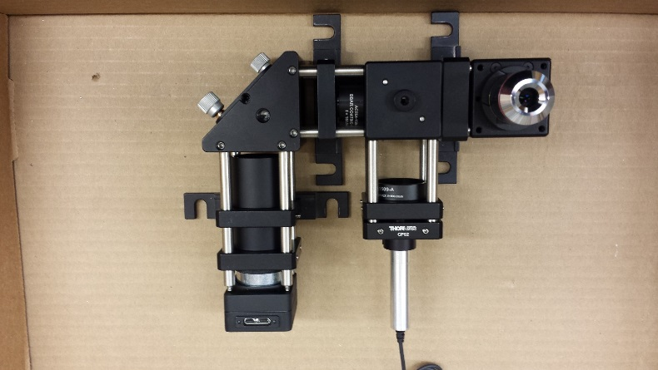
Attach the laser
1) Screw four 2” cage rods into the side of the dichroic cube (CM1-DCH).
2) Screw mounted 100mm lens on to cage plate
3) Slide on the cage plate with the 100mm lens.
5) Slide on the cage plate with the laser. The tip of the laser should be no more than a few mm from the lens.
4) Insert laser (CPS532) into AD8F adapter, tighten set screw. Screw that into a cage plate.

Slide 16
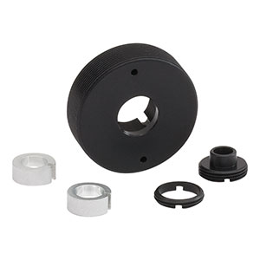
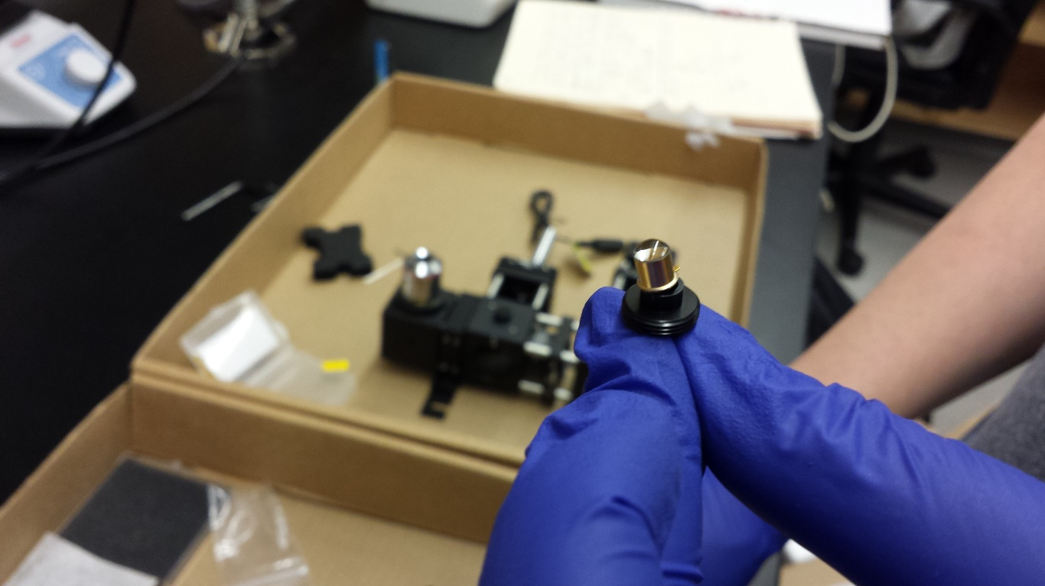
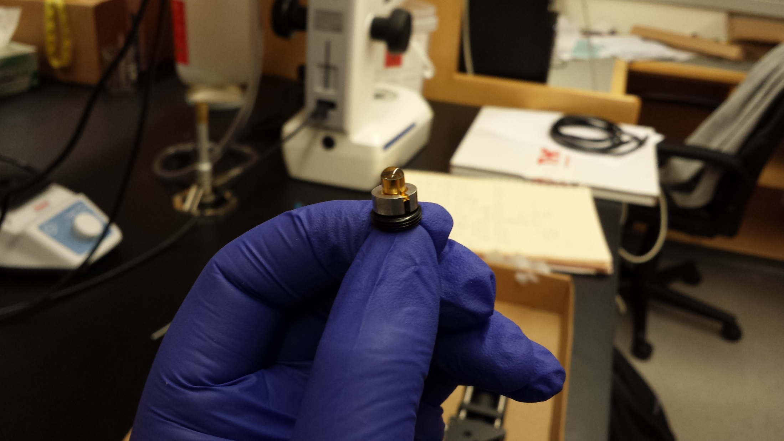
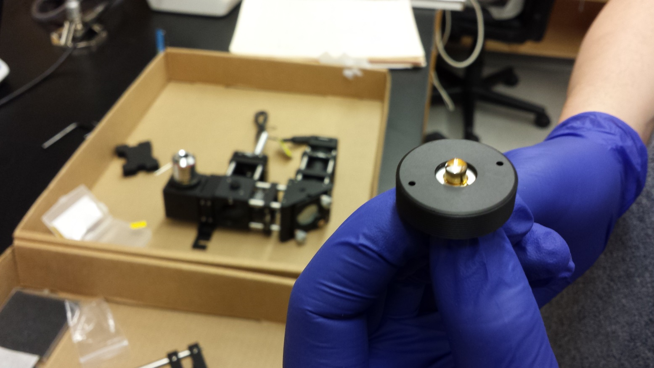
Mount the LED in a cage plate
(3)
(1)
(3)
(2)
(2)
(1)
(don’t need)
0) These are the parts that come in the S1LEDM mounting kit.
1) Thread the LED legs through this part of the S1LEDM.
2) Slide this metal collar over the top.
3) Screw the whole thing into this piece.
4) Screw that into a cage plate.

Slide 17
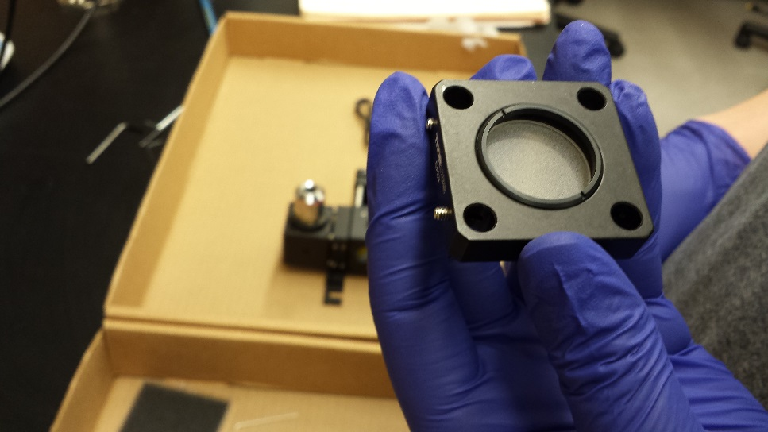
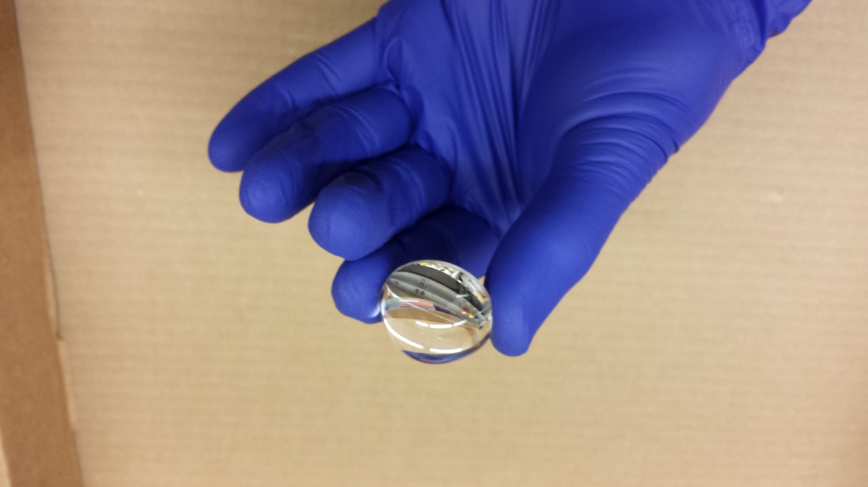
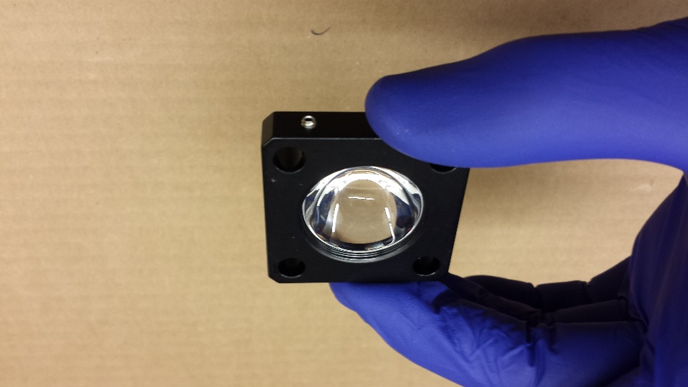
Assemble the diffuser and condenser
1) Remove a retaining ring from a cage plate, drop in the diffuser (DG10-120 ), and screw the retaining ring back in.
2) In a separate cage plate, remove a retaining ring from a cage plate, drop in the condenser lens (ACL25416U), and screw the retaining ring back in.

Slide 18
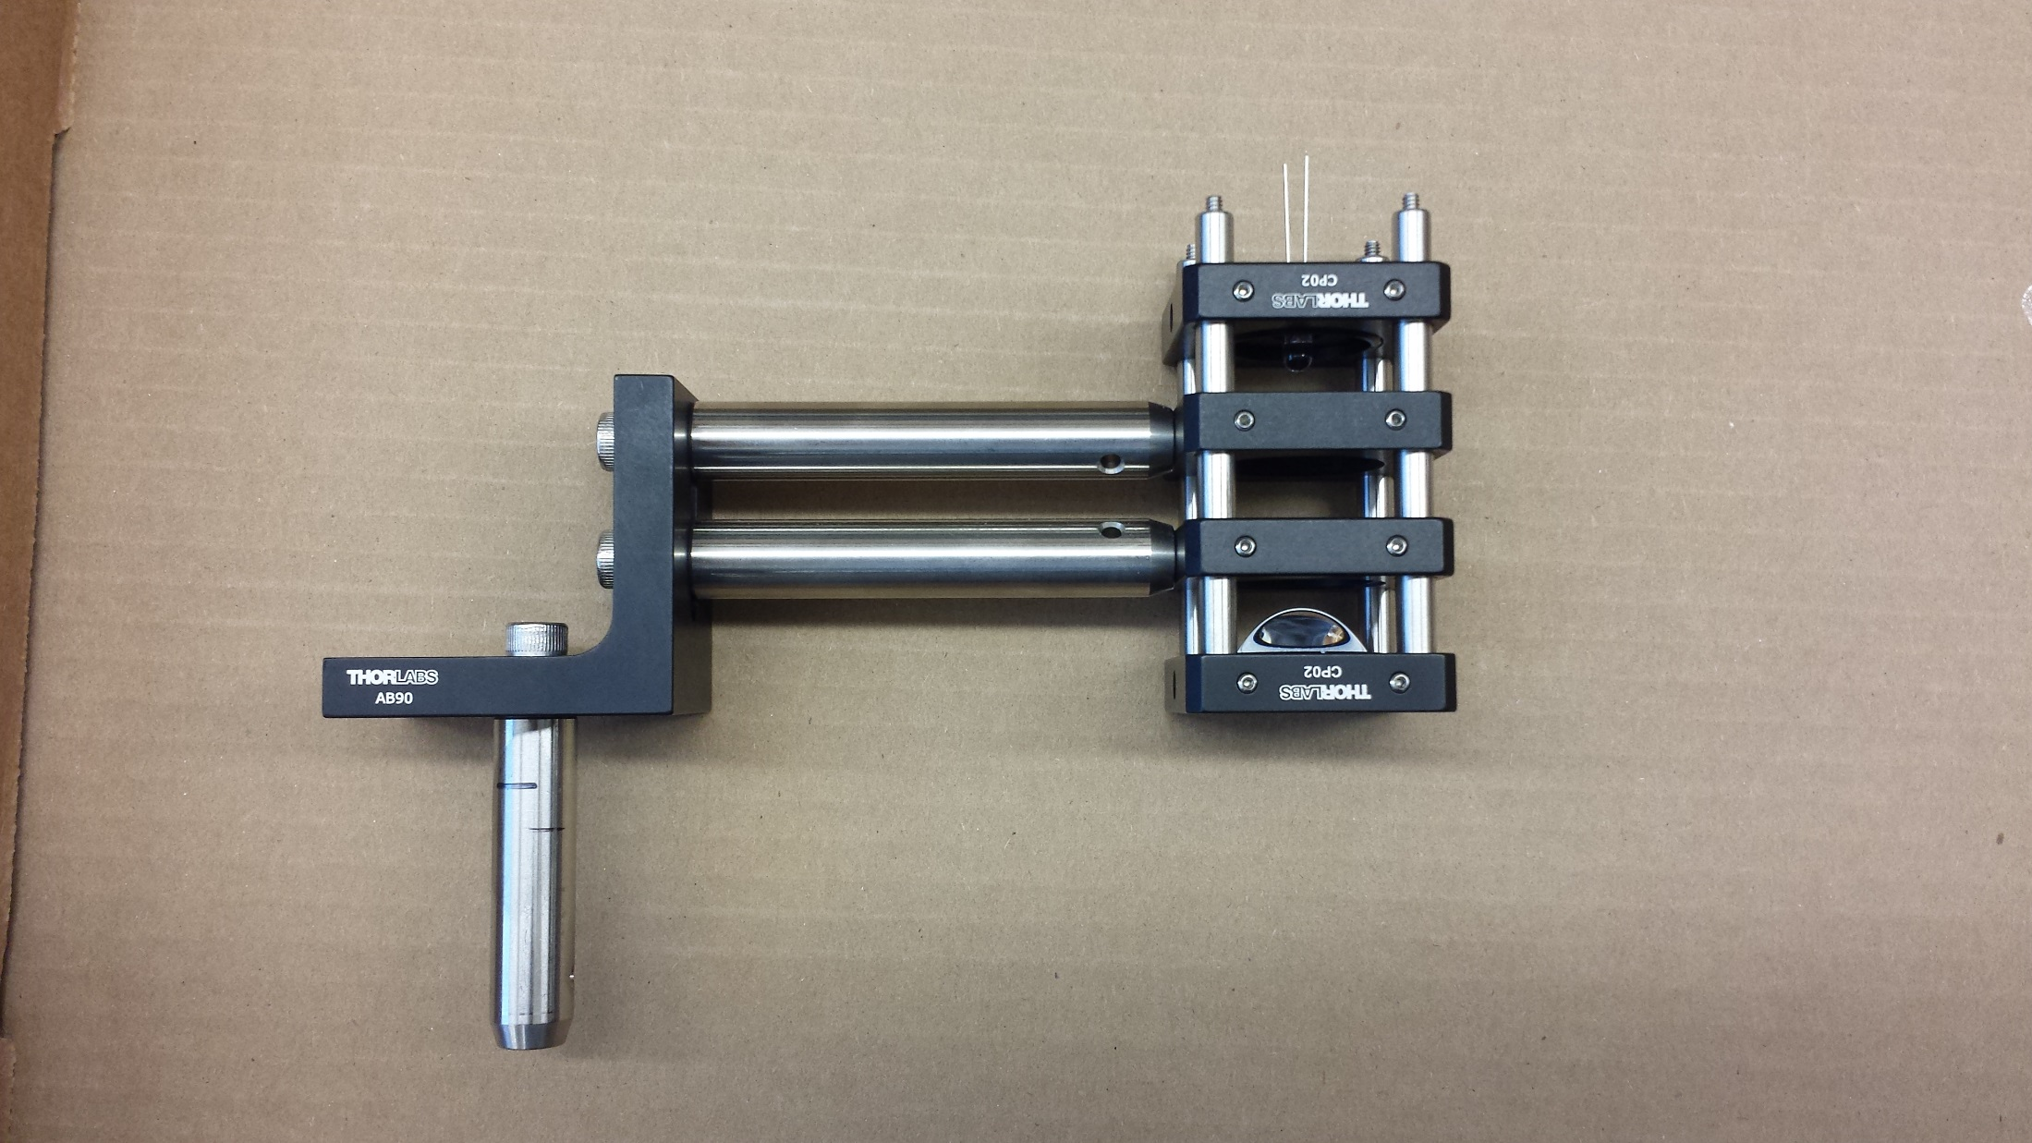
Assemble the illumination axis, attach mounting posts
3” cage rods
this plate holds LED
3” posts (TR3)
(empty)
carries diffuser
carries condenser
Remove these set screws on
the ends of the cage rods

Slide 19
Attach the L-bracket
¼”-20 screws
2” post (TR2)
(ignore my marks on it)

Slide 20
Attach the L-bracket
When bolting to the L-bracket, try to make sure these are level

Slide 21
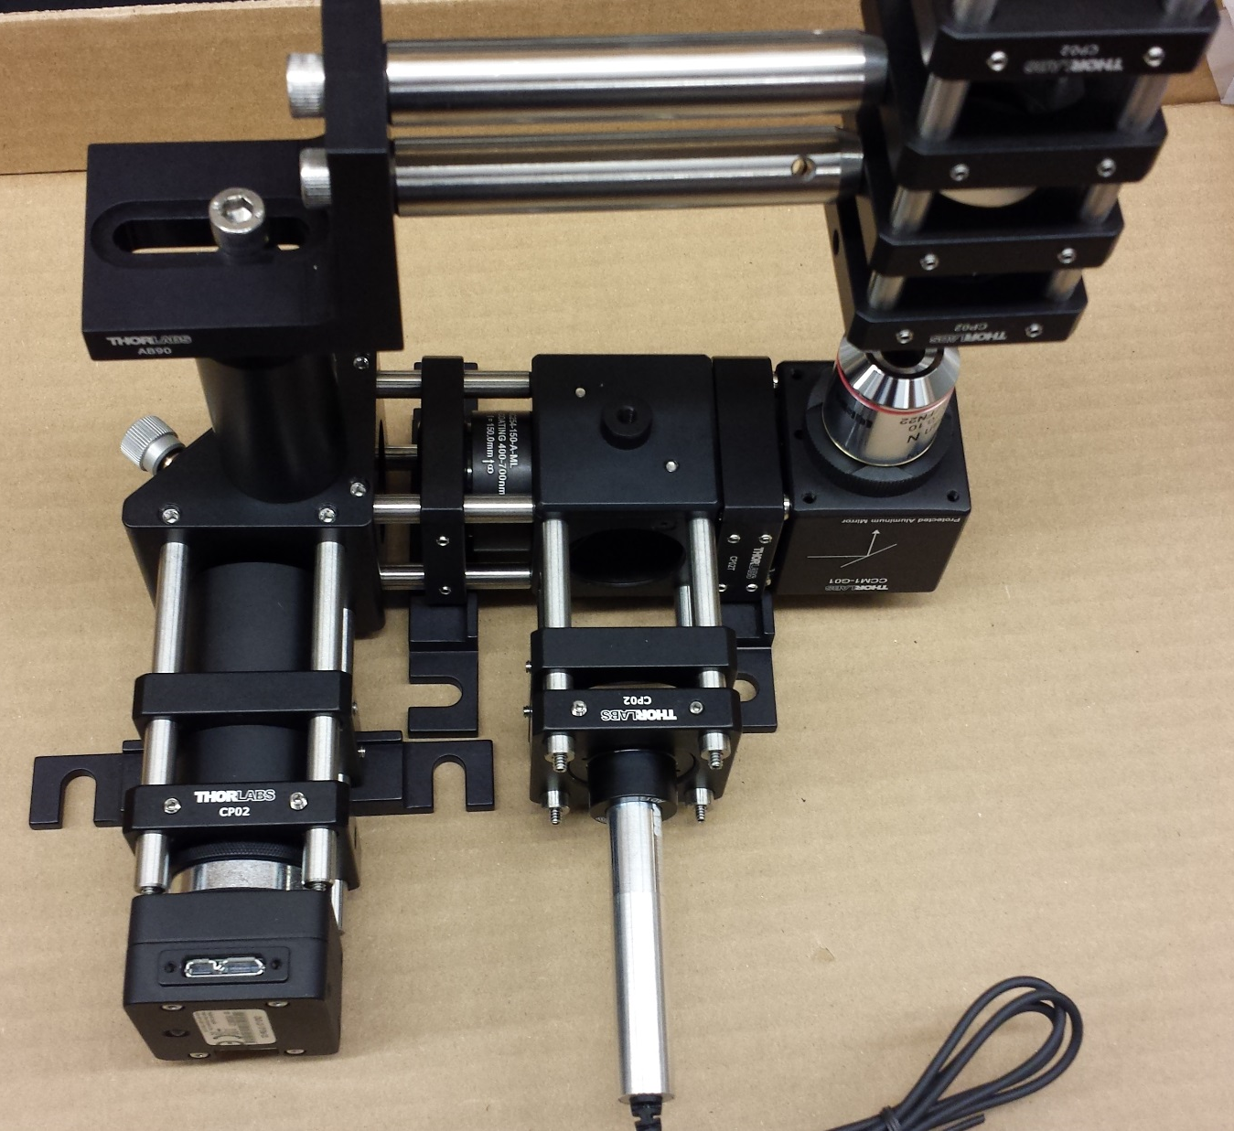
Attach the illumination arm to the rest

Slide 22
Optical assembly is complete. Take a break!

Slide 23
Overview of the axis construction
Note: Almost all of the parts in this section come from openbuildspartstore.com.
The assembly order will be:
Preliminaries (labeling, wheel assembly, etc.)
Assemble z-axis
Assemble y-axis
Assemble x-axis and x’ axis
Putting it all together

Slide 24
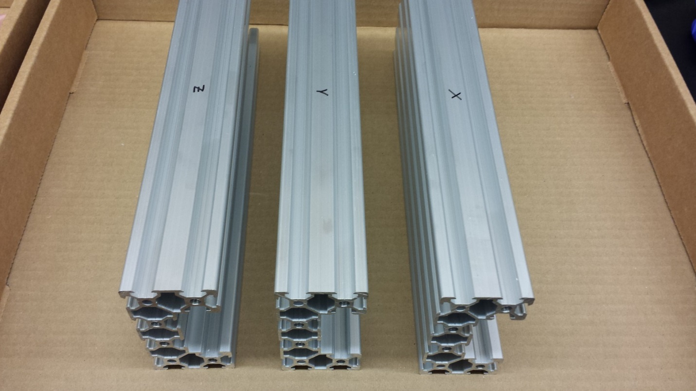
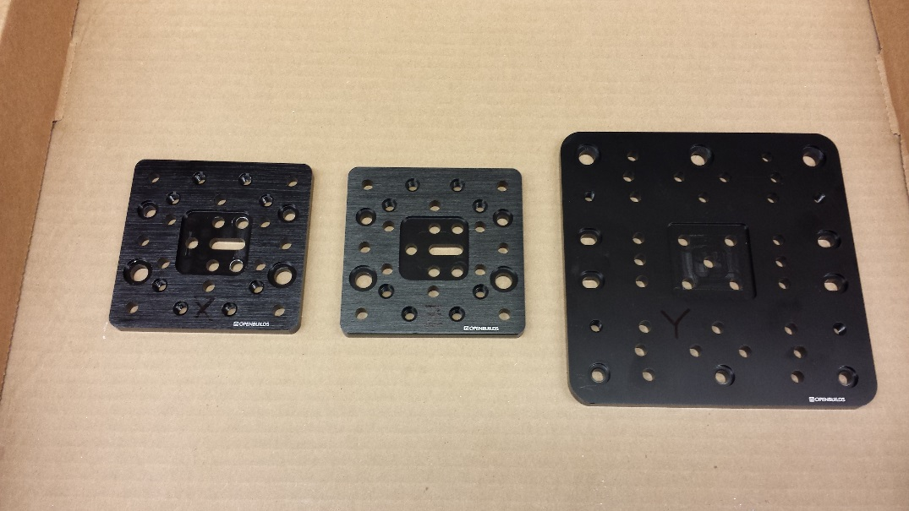
Preliminaries: Label the c-beams and the gantry plates
1) Use a permanent marker to clearly label each C-beam as X, Y, or Z.
2) Do the same for two small gantry plates (X and Z) and one large gantry plate (Y)

Slide 25
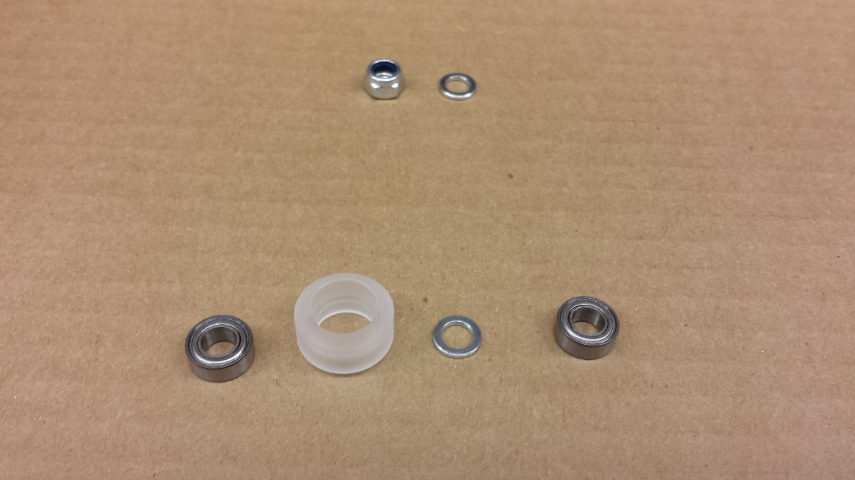
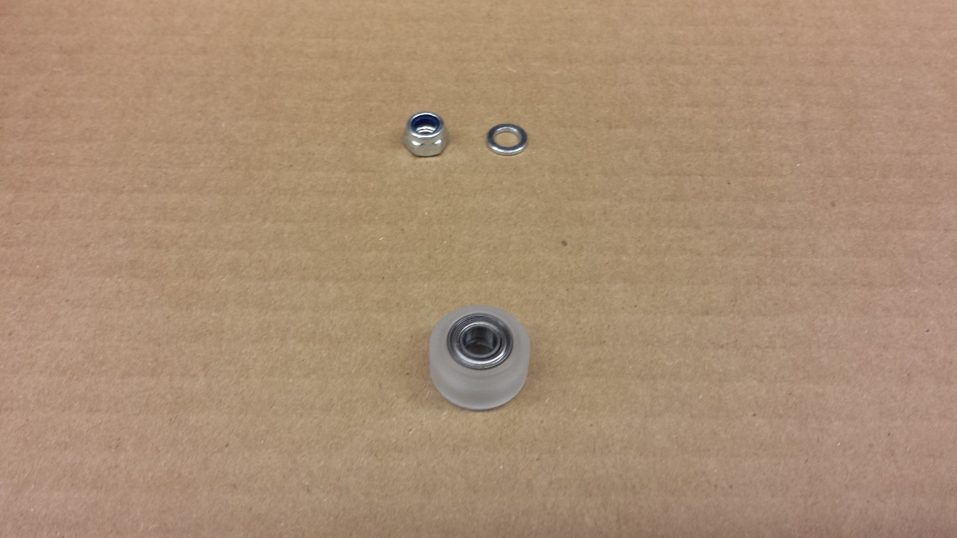
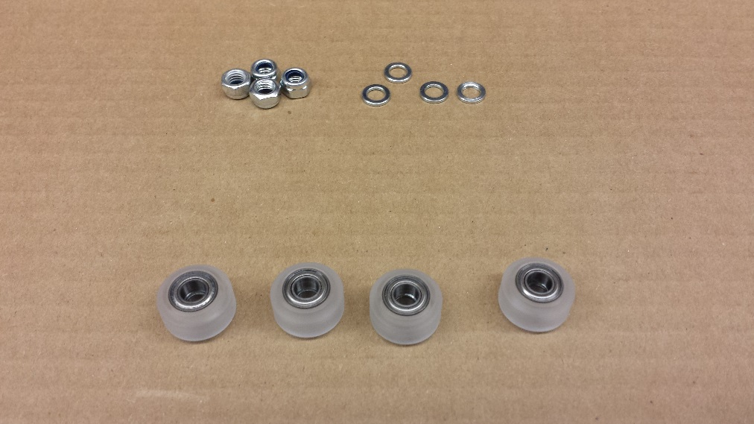
Preliminaries: Assemble the wheels
0) Each C-beam actuator kit contains 4 ‘xtreme mini V’ wheel kits, each of come with a rim, two ball bearings, two shims, and a nut (pictured above).
1) Assemble the wheel by inserting a ball bearing into the rim, then a shim, then another ball bearing.
Now you should have an assembled wheel, a shim and a nut (pictured).
2) Do this for all four wheels.
3) Now do this twice more from the other C-beam actuator kit so you have twelve wheels assembled in total (not pictured).
4) Using the same process, assemble the six larger wheels (openbuilds “xtreme solid V” wheels).
You should now have 12 “xtreme mini V” wheels and 6 larger “extreme solid V” wheels, as well as 14 spacers and 14 nuts left over. You should also have 4 unassembled “extreme mini V” wheel kits left over (from the mini V gantry set), which we won’t use.

Slide 26
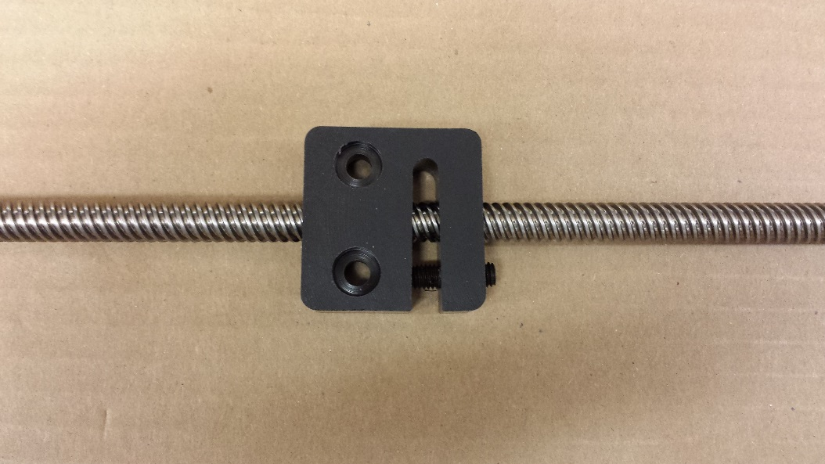
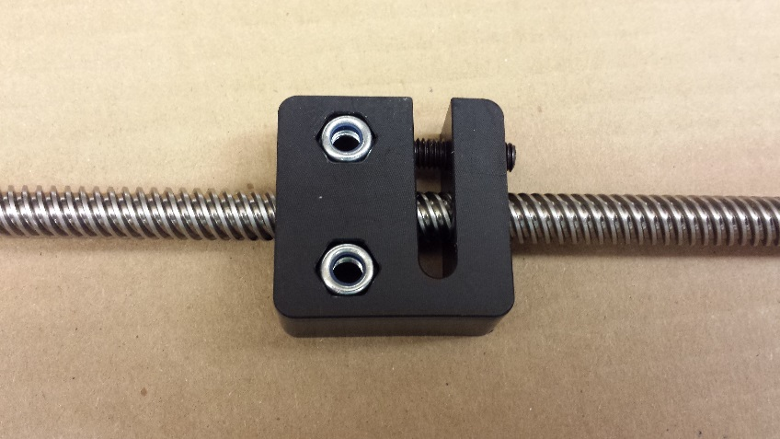
Assemble & tighten the anti-backlash nut blocks
Preliminaries:
anti-backlash set screw
lead screw
Screw in the anti-backlash set screw until it’s just touching the far side.
Thread the nut block onto the leadscrew.
Tighten the anti-backlash set screw until the nut block no longer allows the lead screw to rotate. Now back it off until the lead screw can rotate. This ensures minimal backlash.
nut block
Drop in nuts on the side of the nut block with hexagonal holes.
This is the same for all three axes, so repeat this for the other two nut blocks and leadscrews.

Slide 27
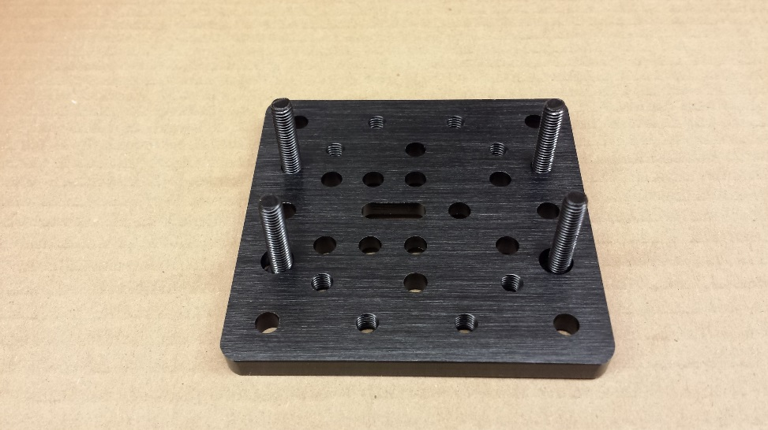
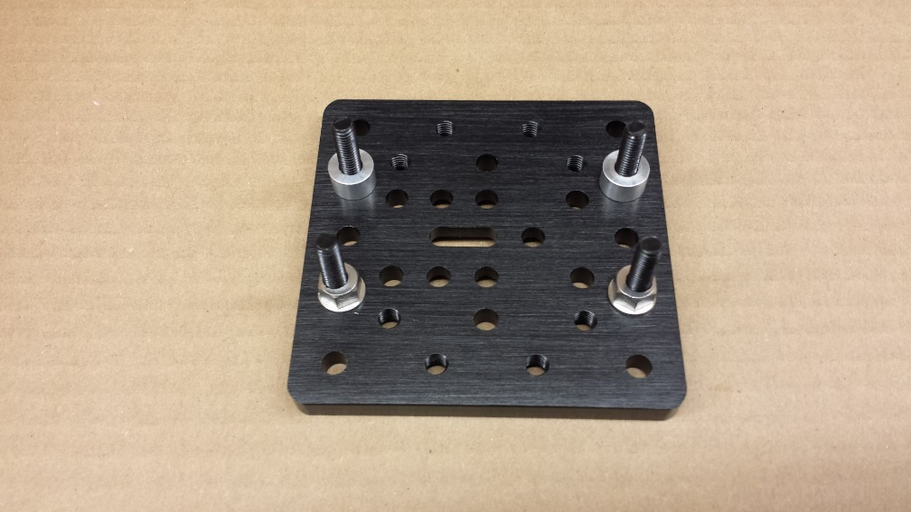
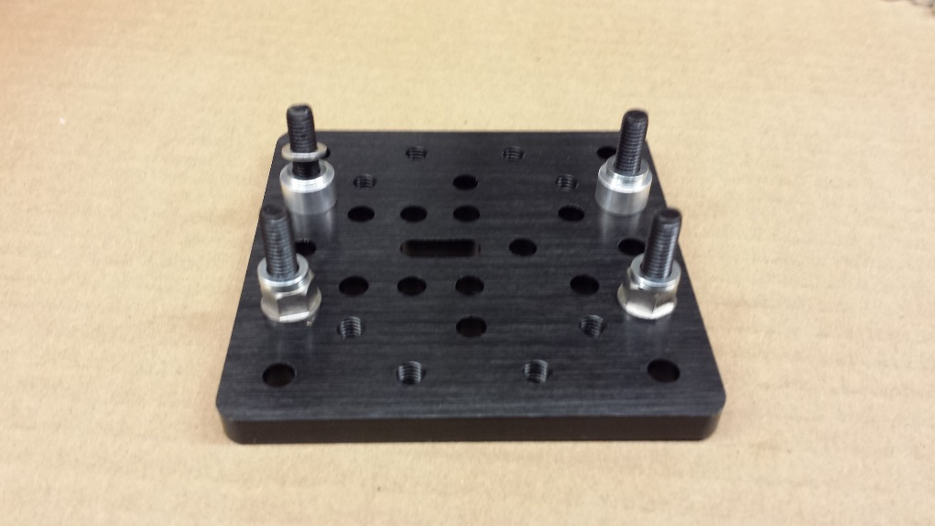


Assemble Z gantry
Assemble Z-axis:
1) 25mm M5 screws
2) Round 6mm spacers on top two, eccentric (also, hexagonal) 6mm spacers on bottom two.
3) Put a shim (washer) on each one.
(take note: this step will vary by axis).
5) Put nuts on each. Fully tighten the two with the round spacer (the back two in this image). Leave the two with the eccentric spacer (the front two in this image) a little loose.
4) Put ‘xtreme mini V’ wheels on each.

Slide 28

Tightening the nuts on the eccentric spacers
Assemble Z-axis:
The eccentric spacers allow you to finely adjust the width between the wheels, and thus how tightly the wheels fit into the groove in the C-beam. You want this to be snug and certainly not loose.
1) Orient the markings on the eccentric spacer towards the nearest edge of the plate, like shown here, then tighten.
2) Try sliding the gantry into the C-beam marked “Z”. It should fit tightly, but still be able to slide. If it is too tight or too loose, loosen the nuts on the screws with the eccentric spaces, adjust the angle of the eccentric spacers, tighten the nuts, and try again.

Slide 29



Affix the nut block to the Z gantry plate
Assemble Z-axis:
1) 20mm M5 screws
2) 3mm spacers
3) Put nut block on, tighten screws mostly but leave enough room for the nut block to wiggle a little (we’ll tighten it in a minute).

Slide 30



Slide Z gantry into C-beam, add bearings and lock-collars
Assemble Z-axis:
A
1) Attach one endmount (A) plate to the C-beam with 4 20mm screws. Slide gantry into c-beam (B).
B
Ball bearing
Washer
Ball bearing
Lock collar
Washer
Lock collar
2) Add bearings, washers, and lock-collars
3) Slide gantry to left until the end of the leadscrew is just shy of flush with the endmount. Seat the ball bearing in the recessed endmount hole, and tighten the lock-collar on that end.

Slide 31




Add tee-nuts, bolt end-mounts onto the C-beam
Assemble Z-axis:
1) Add 2 tee-nuts into the first and third slots on the underside of the c-beam (used later to mount the circuit board), and one tee nut into each side slot (as shown).
2) Attach an endmount the other end (uses four 20mm screws for each).
3) Tighten set-screws on the lock-collar on that end.
4) Now finish tightening the screws that attach the nut-block to the gantry.

Slide 32




Add stage-holder and mounting blocks
Assemble Z-axis:
1) Attach the “stage holder” to the gantry as shown, using 8mm screws. You will have to first separate the two halves of the stage clamp by bending them back and forth repeatedly until they break apart.
2) Attach a cube corner connector on the side of the z-axis (bolt into the tee nut).
3) Do the same for the other side.
…done with the z-axis!
onto the y-axis.

Slide 33





Assemble the Y gantry plate
Assemble Y-axis:
1) Use six 25mm M5 screws.
2) 6mm spacers on the back three screws, eccentric spacers on the front three.
3) Put the wheels on, then add and tighten the nuts the nuts. Note: no shims/washers here! These wheels are a bit bigger, therefore we won’t need them here.
4) Two 20mm M5 screws in the center two holes, with 3 mm spacers on each. Attach the nut block (as before), and leave it a little loose.
5) Slide the gantry onto the Y-axis c-beam. Adjust orientation of eccentric spacers as needed (as on p28) to ensure smooth but firm motion of the gantry.

Slide 34



Add endmount to c-beam, then attach gantry with bearings and lock-collars
Assemble Y-axis:
A
1) Attach one endmount (A) plate to the C-beam
with 4 20mm screws.
Slide gantry onto c-beam (B).
B
Ball bearing
Ball bearing
Lock collar
Washer
Washer
Lock collar
2) Add bearings, washers, and lock-collars
3) Slide gantry to left until the end of the leadscrew is just shy of flush with the endmount. Seat the ball bearing in the recessed endmount hole, and tighten the lock-collar on that end.

Slide 35




Add tee-nuts to C-beam slots, then add second endmount onto C-beam
Assemble Y-axis:
1) Insert six tee nuts as shown into the underside of the Y axis C-beam.
2) Attach second end-mount plate to C-beam with four 20mm screws
3) After ensuring gantry moves smoothly, tighten screws holding the nut-block onto gantry plate

Slide 36

Assemble the “mini V Gantry set”
Assemble Y-axis:
(Same process as ‘Assemble Z gantry’ slide).
Four 25mm screws through the corner holes
Two round 6mm spacers, two eccentric spacers (as shown).
Two shims (washers) on each of the four screws.
Xtreme mini V wheels
Nuts
Tighten nuts on screws with round spacers. Partially tighten nuts on screws with eccentric spacers.
Adjust tension on linear rail via adjusting orientation of eccentric spacers (same process as “tightening the nuts on the eccentric spacers” slide).
Drill out the two holes circled at left to remove the threads, using a 3/16” drill bit.

Slide 37







Assemble the X gantry
1) 25mm M5 screws
2) Round 6mm spacers on top two, eccentric (also, hexagonal) 6mm spacers on bottom two.
3) Put two shims on each one.
4) Put ‘xtreme mini V’ wheels and nuts on each. Fully tighten the two with the round spacer, but leave the two with the eccentric spacer a little loose.
5) Try sliding the gantry inside the C-beam. Adjust the eccentric spacer orientation as necessary so that it provides a tight fit. See the slide “Tightening the nuts on the eccentric spacers.”
6) Put in two 20mm M5 screws.
7) Put a shim (washer), on each screw, followed by 3mm spacer.
8) Screw the M5 screws into the nut block, tighten most of the way but leave a little wiggle room.

Slide 38


Attach X gantry and mini-V gantry to the underside of the Y-axis
Assemble Y-axis:
1) Flip the y-axis over, arrange the tee nuts roughly as shown.
2) Using 10mm screws, bolt the x-axis gantry and the mini-V gantry to the y-axis underside, as shown. Make sure the mini-V gantry (left) is flush with the outer edge of the endmount plate, and the x-axis gantry (right) is flush with the inner edge of the endmount. It is essential these both be as straight as possible.

Slide 39
Axis assembly is complete. Take a break! next up: printed circuit board (PCB) assembly

Slide 40

Assembling the PCB:
Use this image for reference when soldering
optoMOS switch
(CLA230CT-ND)
Teensy (1568-1231-ND) with headers on
top of teensy headers (1568-1422-ND)
two-pin header for LED (609-3401-ND)
audio cable jack
(CP-2523MJCT-ND)
Motor driver (drv8825) on top
of 8 pin headers (57006-ND)
5V regulator
(497-1443-5-ND)
1 uF ceramic
capacitor
Shrouded connector
(WM4926-ND)
Power cable jack
(CP-102BH-ND)
47 uF electrolytic cap
(P5581-ND)
140 ohm resistor (541-140AFCT-ND)
Video guide to basic through hole soldering: https://youtu.be/f95i88OSWB4

Slide 41


Assembling the PCB:
First, solder on surface mount components
It’s easiest to start by soldering the surface mount parts
(capacitors, resistors, optoMOS switches, and audio cable jack)
while there’s nothing else in the way.
A quick video on surface mount soldering can be found here:
https://www.youtube.com/watch?v=y0InEFdWfZc
It’s a good idea to check under
a microscope (or with a loupe or
magnifying glass) that no terminals
have been soldered together
The board will look like this:
(the audio jack isn’t there yet)

Slide 42

Solder through-hole components
Assembling the PCB:
Next solder on all the headers. The board will look like this:
(Note the header pins have been inserted into the teensy headers)
It can be helpful to secure the headers with clips before soldering them.
Tape will do in a pinch.

Slide 43
Assembling the PCB:
Final soldering steps
Lastly, solder the teensy onto the pins, and solder on the power cable connector, the electrolytic capacitors, and the voltage regulator.
The voltage regulator should be arranged so that the output pin is closest to the power cable connector.
Important: The positive pin of the electrolytic caps (the one with the longer lead) goes through the square hole on the board.
Remember to check your soldering carefully for accidental joins or bad connections!

Slide 44

Assembling the PCB:
Set current limits on DRV8825 motor controllers
Plug in the 12V power supply so that the board receives power.
Get a screwdriver and a voltmeter.
Turn the screw on the DRV8825s, typically about a quarter turn, then check the voltage on that screw relative to ground using the voltmeter. You should turn the screw till the voltage is 0.4V (yielding a 0.8A current limit).
Measure voltage here
A video explaining this process is here: https://www.youtube.com/watch?v=89BHS9hfSUk.
grounds

Slide 45
The breadboard layout
Putting it all together:
Use this slide as a reference for the next set of slides.
Y axis C-beam
X axis C-beam
V-rail
motor
Z axis
C-beam
motor

Slide 46

Attach feet to breadboard
Putting it all together:
Use the provided setscrews to attach the rubber feet (thorlabs, AV6) to the breadboard (thorlabs, MB12). Attach them one screw interior from each corner (as shown).

Slide 47




Bolting down the X axis C-beam and the V-slot linear rail
Putting it all together:
1) Flip the board right side up.
2) Put tee nuts into the V-slot linear rail and the X-axis C-beam, as circled above.
Also, bolt one endmount onto the x-axis c-beam (red arrow).
3) Using 8mm M5 screws, bolt the cube corner connectors to the tee nuts, ensuring that, in the orientation shown above, small holes in the cubes are on the right faces and large holes are on the left faces. Don’t tighten the screws all the way yet.
4) Rotate the rails 90 degrees so that the cubes rest on the breadboard. Ensure the cube holes are well aligned with the breadboard, then tighten the screws the rest of the way. Finally, bolt the cubes to the breadboard with ¼”-20 screws.

Slide 48



Add the Y axis.
Putting it all together:
1) Slide y-axis onto the two rails. Make sure the the mini-V gantry is snugly on the linear rail (left) and the x-axis gantry is snugly in the C-beam (right).
2) As previously, put a lock-collar, washer, and ball bearing on each end of the leadscrew (only visible on one end in this picture).
4) Attach the other endplate with four 20mm screws. Make sure the leadscrew is flush with the outside of the end plate, then tighten the lock-collar.
5) Tighten the lock collar on the other end.
3) Slide the gantry down until the leadscrew is protruding from the endmount and the ball bearing is in the recessed hole (circled).

Slide 49




Bolt down the Z axis
Putting it all together:
1) Place the z-axis c-beam on the board.
2) Use 1-1/8” long ¼”-20 screws to bolt the z-axis down on both sides. Note that these cannot both be simultaneously nicely aligned to the breadboard holes (an admitted weakness in the design), but they can be made to go into the holes just the same.
3) Use step clamps (top) to bolt down the front lip of the z-axis endmount.

Slide 50







Attach the motors (same process for all 3)
Putting it all together:
1) Slide the flexible coupler onto the leadscrew (only one side will fit).
4) Align the motor shaft and the 55mm screws with their respective holes in the coupler and the endmount, respectively.
2) Tighten the set screw to fasten the flexible coupler. Make sure to leave 2-3mm between the coupler and the endmount.
5) Screw in the 55mm screws (circled) to fasten the motor in place.
6) Tighten the set-screw on the flexible coupler. Make sure the set screw is contacting the flat of the motor shaft.
3) Put 55mm M5 screws through mounting holes on the motor. Then slide 40mm spacers over them.

Slide 51



Attach the optics!
Putting it all together:
Using 8mm screws with washers, bolt the optical train to the Y-axis gantry at the points circled.

Slide 52



Add the glass stage
Putting it all together:
1) Turn the flexible coupler to move the z-axis gantry. Move the z-axis gantry until in between the objective and the condenser lens (middle panel).
2) Put in the 5” square glass plate. If it’s loose, loosen the screws on the z-axis gantry, tighten the clamp, and re-tighten the screws.

Slide 53




Fasten the circuit board to the z-axis
Putting it all together:
1) Cover the back side of the circuit with electrical tape to avoid shorts when bolting it to the z-axis.
2) Cover a section of the z-axis with tape (to further prevent shorts). Using the tee nuts, bolt the board to the C-beam as shown.

Slide 54
Wiring everything up
Putting it all together:
Camera connects to computer with usb3 cable (Digikey Q549-ND)
Laser connects to PCB with 2.5mm audio cable (Digikey part CP-254S-M/M-ND) (why, thorlabs??? why?)
LED connects to PCB via 2-connector cable (Digikey part 1175-1261-ND)
PCB is powered via 12V 5A brick (Digikey 96PSA-A60W12V1-1-ND)
Teensy on PCB is connected to computer via micro USB cable (Digikey Q853-ND).
Motors connect to PCB via handmade connector.

Slide 55

Wiring everything up
Putting it all together:
To power supply
Motor wires should go
black, green, red, blue
from left to right when connected to the PCB. (we will not use the yellow or white wires).
To laser
(cable not
shown)
To z axis motor
To LED
To y axis motor
(via homemade
extension cable)
To x axis motor
To computer

Slide 56

Attaching connectors to wires/cables
Need to
Add connectors to each bundle of 4 wires from the motors
Make a 4-conductor extension cable
Basic steps
Expose a section of wire
Crimp on crimps
Slide the crimp connector into the socket

Slide 57
You put it all together. Go you! Now, let’s test it out.

Slide 58
Programming teensy and testing out scope functionality via serial interface
Install Arduino IDE
Install teensyduino
To program the Teensy, open teensyCode/scopeController/scopeController.ino in the Arduino IDE and click the right arrow in the top bar (you may also need to set the port under Tools > Port).
Open up a serial terminal (Tools > Serial Monitor). Type 'E' and hit enter to enable the motors (you should hear a hiss from the motors when they are enabled). Type 'e' and hit enter to disable the motors. Type "X100" to go to x position 100 (note this will only work if the motors are enabled; otherwise the command is ignored. The next page contains a full list of commands.
Note also that the teensy will send its current position every 5ms.

Slide 59
Teensy serial commands
Command | Function
l | LED off
L | LED on
k | Laser off
K | Laser on
e | Disable motors
E | Enable motors
X100 | go to x coordinate 100. all coordinates are absolute, and are in number of steps (according to the current stepping mode!).
Y-3000 | go to Y coordinate -3000
Z832 | go to Z coordinate 832
SX500 | sets max speed on x axis to 500 steps/sec (default is 1000);
AY20000 | sets acceleration on Y axis to 20000 steps/sec/sec (default is 50000 for X and Y, 5000 for Z)
MY3 | sets microstepping mode on Y axis to 1/2^3 = eighth steps. Default is 5 (1/2^5=1/32 steps = smoothest motion).

Slide 60
Labview tracking software
Requires:
NI Labview full 2017 or later
NI Vision Acquisition Software
NI Vision Development Module

Slide 61
Laser alignment

Slide 62
notes
1) it doesnt illuminate the edges of the image. This is expected. The laser puts out a 3mm beam diameter, which is not full-width half max - FWHM is generously something like 2mm. After the lens and the objective, which form a beam expander (shrinker in this case) of magnification equal to the ratio of their focal lengths (focal lens of lens1 is 100mm, focal length of objective is 45 mm), the beam diameter becomes 2mm * 45/100 = 900um. Since your full field of view is ~1.8 x 1.5 mm (camera sensor size is 6144x4901um, reduced by a magnification of 3.3x [focal length of tube lens: [150mm] / focal length of objective [45mm] = 3.33333x] the fov is 1.843x1.47mm).
Here's the tradeoff: you can reduce the focal length of the laser lens (e.g. to 75mm or even 50mm) to make the laser cover more of the field of view. BUT, the intensity will drop, because the same 4.5W illumination is now covering a bigger area. In our case, given how crummy the objective is and the intensity demands for optogenetics, I figured more laser power in the center image would be preferable to weak but uniform illumination. Fortunately, most worms are smaller than our FOV, so we don't necessarily need to illuminate the full FOV.

